Slide 1
ICONIC UC H2H
77242113UCO3002
JNJ2113 Phase 3b UC Trial
Protocol Overview and SipIQ KOM
19May2026
This meeting will be recorded

Slide 2
Agenda
Topic | Speaker | Timing
Welcome & Team Introduction | Li Jen Heng, TDL | 5 min
Moderate to Severe UC Overview: Unmet Need and Opportunity for a H2H Trial | Yelina Alvarez, SRP | 5 - 10 min
Compound Overview​ ​ | Lindsey Surace, Clinical Lead | 5 min
Phase 3b Program Overview​ Study Design Key Eligibility Criteria​​ Site Profile | Nicole Houck, SRS | 15 min
Feasibility Enrollment Assumptions, Timelines and Country List Site List Development Process & Customized Flags SipIQ/SDT process Next Steps | Liz Monti Sullivan, Feasibility Lead Cathy Bismark, FAM Jenifer Eche, FM | 25 min
Questions​ | All

Slide 3
Team Introduction

Slide 4

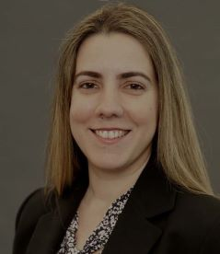

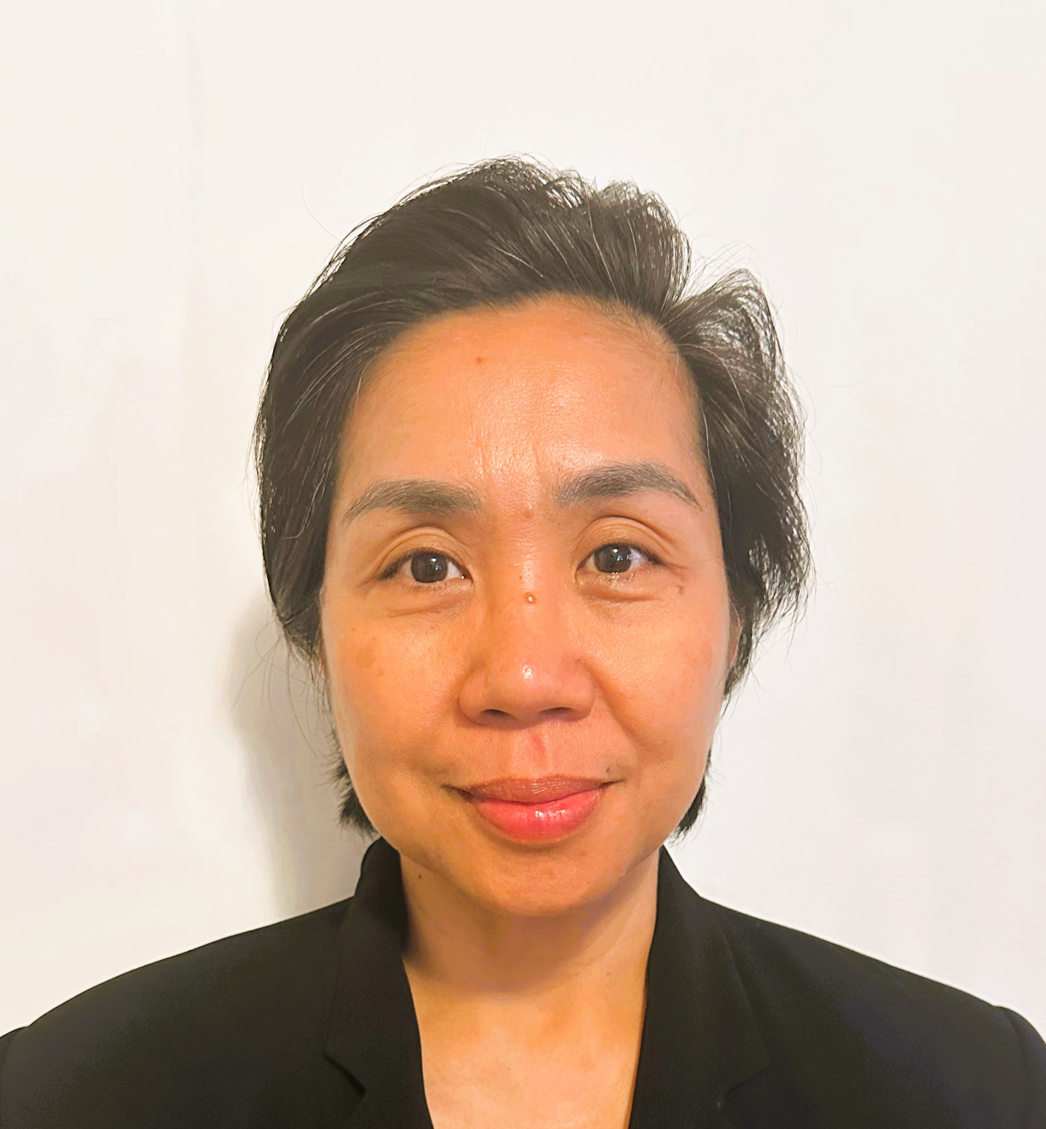


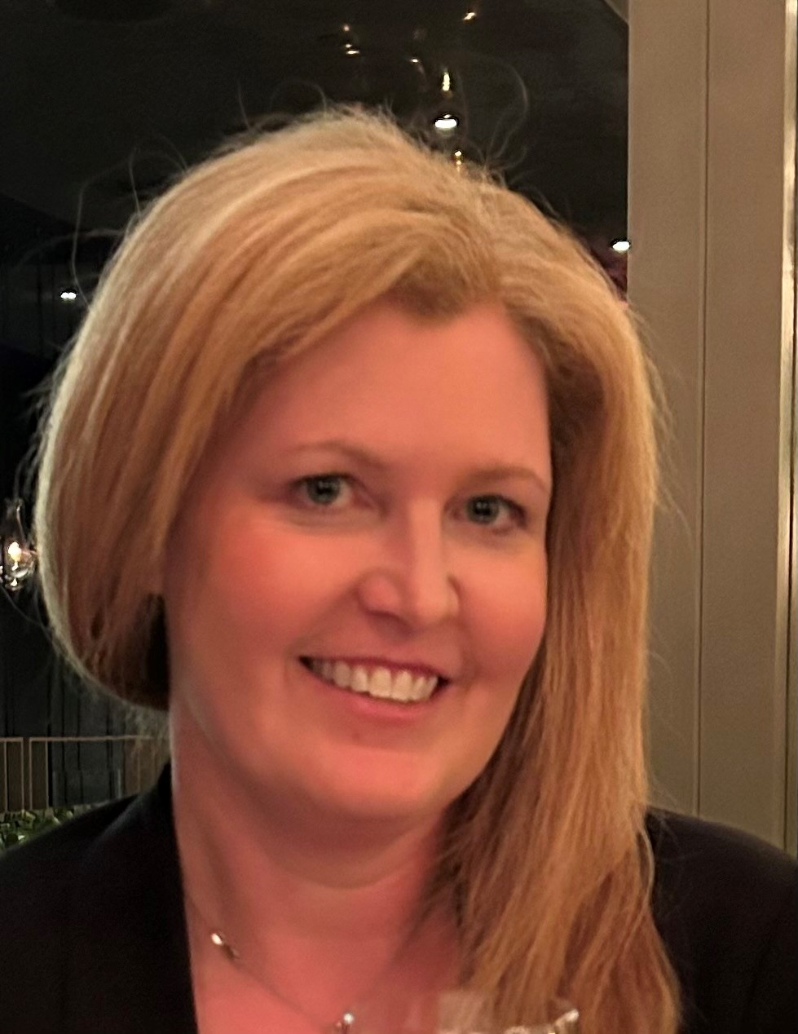

ICONIC UC H2H Central Team
Clinical Team
Delivery Unit
Lindsey Surace
Clinical Lead
Yelina Alvarez
SRP
Liz Sullivan
Feasibility Lead
Jenifer Eche
Feasibility
Nicole Houck
SRS
Jeanine Ranaudo
PDL
Li Jen Heng
TDL
Ann Campbell
TDM-coordinating

Slide 5
Our Purpose

Slide 6
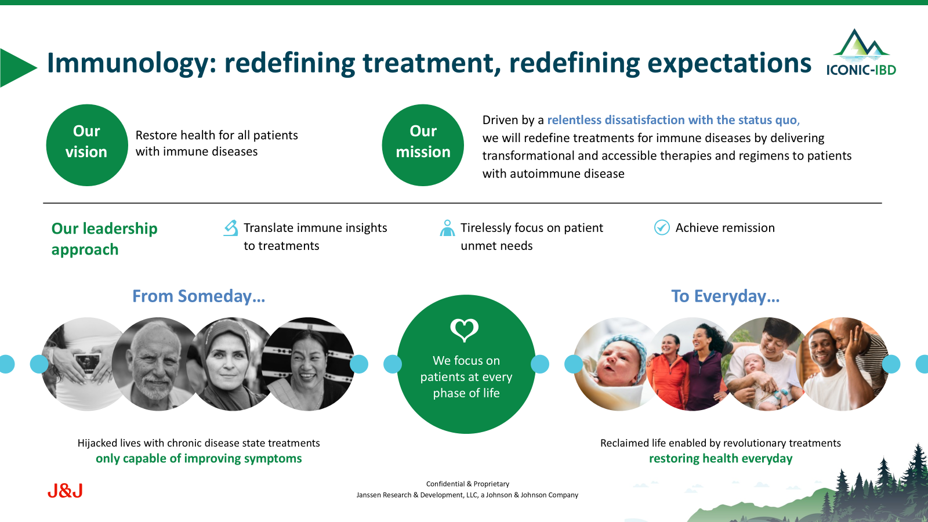

Slide 7
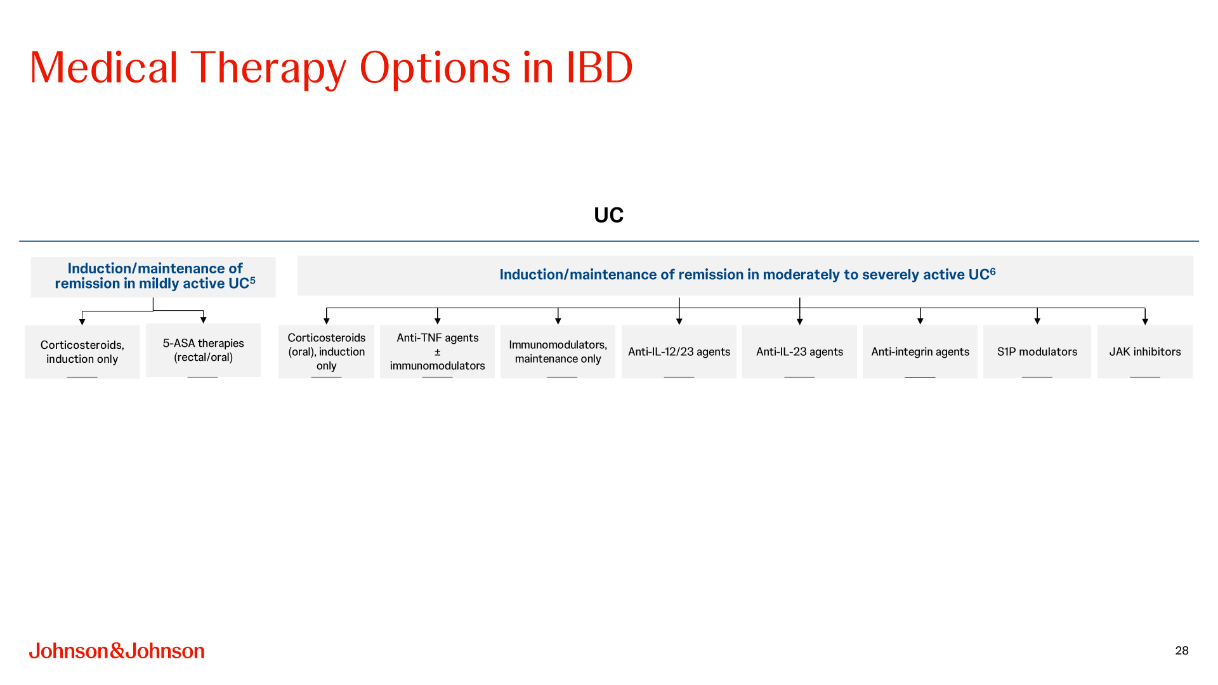

Slide 8

JnJ is investing in an IBD pipeline portfolio that addresses the persisting unmet need in IBD
Guselkumab
Dual-acting selective IL-23i
Unique therapies designed to meet IBD patients' needs across the spectrum of disease severity
Icotrokinra
A first-in-class targeted oral peptide that blocks the IL-23 receptor
JNJ-4804
A first and only co-antibody therapeutic of IL-23i and TNFi
The safety and efficacy of these investigational products and/or investigational uses of approved products have not been established and there is no guarantee that such investigational product/uses will be filed with and/or approved for marketing, For more information, visit clinicaltrials.gov

Slide 9


Business Case: Icotrokinra UC Ph3 program designed for streamlined approval, speed to market & optimal regulatory package
HIGHLY CONFIDENTIAL – DO NOT DISTRIBUTE
2023 | 2024 | 2025 | 2026 | 2027 | 2028 | 2029 | 2030 | 2031
UC Ph2b (ANTHEM)
UC Ph3 (ICONIC-UC)- RWD; 1 ind., 1 or 2 maint. doses (N~800) + adolescents
LTE
UC Ph3b (ICONIC-UC H2H): Open label
US: Feb’29; EU: May ’29
JP: Jun’29
Phase 3b: Direct Comparison Trial (H2H)
Supports Access in key EU/RoW markets
H2H studies are infrequent in UC
  Success case: Vedolizumab demonstrated superiority over adalimumab
  Abbvie has announced H2H rizankizumab vs vedolizumab (REVAMP)
Clinical superiority will facilitate access strategy
H2H is essential to position ICO as an early therapy in UC
Clinical superiority is a critical driver for medical adoption

Slide 10
Compound Overview

Slide 11
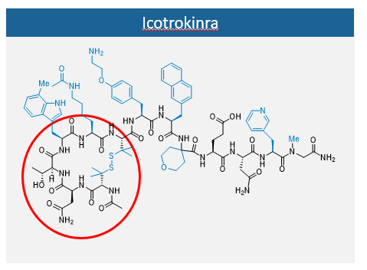
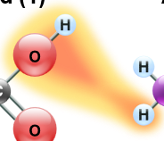
Icotrokinra: a precise peptide
Proteins are long chains of peptides (polypeptides)
Amino acids
Peptides are short chains of amino acids linked by peptide bonds
Amino acid (1)
Amino acid (2)
H
H
H
Peptide bond
H
O
H
H
O
H
H
O
H
N
C
C
N
C
C
H
N
C
C
H
H
H
R₂
O
R₁
O
R₂
O
N
C
C
H
R₁
O
N-terminus
C-terminus
Protein
Dipeptide
Nelson DL, Cox MM. Principles of Biochemistry. 7th edn. New York, NY: WH Freeman & Co.; 2017.
Notes:
This slide introduces icotrokinra as a precise peptide and explains the basic building blocks of peptide-based therapies.
Amino acids are the smallest unit shown here — they link together through peptide bonds to form short chains called peptides.
Proteins, by contrast, are much longer polypeptide chains. Icotrokinra sits in the peptide range — small and precisely engineered.
The key takeaway: peptides occupy a sweet spot between small molecules and large proteins, which is what makes icotrokinra unique as a therapeutic.

Slide 12
Peptides vs small molecules vs mAbs
Small molecules^{1–3}
MW ≤ 500 Da³
Peptides³
MW < 5000 Da
mAb^{2,3}
MW of ~ 150,000 Da
Peptide therapies
can be designed to be suitable for oral delivery, providing a therapeutic option that combines the benefits of small molecules and mAbs
Advantages
Permeable
High biodistribution
Ideally suited for
oral administration
    mAb-like specificity
    and potency
Effectively prevents cytokine–receptor interactionsª
    Small molecule-like biodistribution
    Low risk of drug–drug interactions
Advantages
Effectively prevents
cytokine–receptor interactionsª
High specificity
High potency
Challenges
May not effectively
disrupt cytokine–receptor interactionsª
Limited selectivity
(off-target effects)
Challenges
Impermeable
Limited biodistribution
Unsuitable for oral formulation (invasive injection only)
Icotrokinra^{3,4} MW = 1,898.19 Da
Increasing molecular size
mAb, monoclonal antibody.
a Protein–protein interactions involving large, flat surfaces.^{5–8}
1. La Manna S, et al. Int J Mol Sci. 2018;19:2714. 2. Castelli MS, et al. Pharmacol Res Perspect. 2019;7:e00535. 3. Stein Gold L, et al. Adv Ther. 2025;42:3158-72. 4. Fourie AM, et al. Sci Rep. 2024;14:17515. 5. Wang L, et al. Signal Transduct Target Ther. 2022;7:48. 6. Arkin MR, et al. Chem Biol. 2014;21:1102-14. 7. Lu H, et al. Signal Transduct Target Ther. 2020;5:213. 8. Zheng J, et al. Bioorg Med Chem Lett. 2021;48:128229.
Notes:
This slide compares three therapeutic modalities: small molecules, monoclonal antibodies (mAbs), and peptides. The goal is to show where icotrokinra fits and why peptides offer a unique advantage.
Small molecules (MW ≤ 500 Da) are highly permeable and orally available, but they often lack the selectivity to effectively block cytokine–receptor interactions, leading to off-target effects.
mAbs (~150,000 Da) have high specificity and potency, but their large size makes them impermeable and unsuitable for oral delivery — patients must receive them by injection.
Icotrokinra (MW ~1,898 Da) is a peptide that combines the best of both: mAb-like specificity and potency with small molecule-like oral bioavailability and biodistribution, plus a low risk of drug–drug interactions.

Slide 13
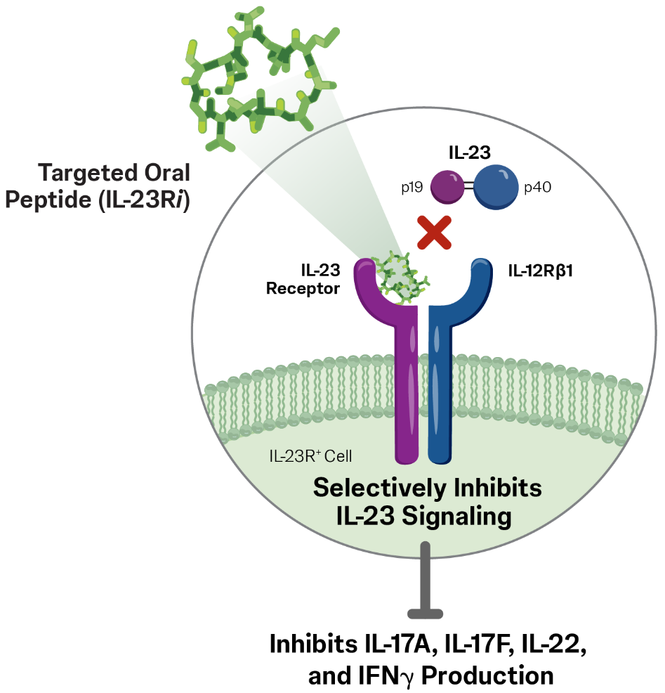
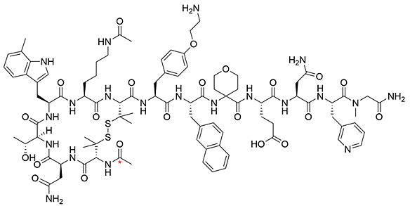
Icotrokinra: the first targeted oral peptide that precisely binds IL-23R, blocking IL-23 signalling
Highly selective and potently blocks IL-23 from binding to its receptor
Icotrokinra is an innovative cyclic peptide that is stable in GI tract
Target expression is low and is mostly restricted to inflamed tissue
IL-23R⁺ cell
Small size allows great penetration of target tissues
Precisely inhibits
IL-23 signalling
No known
off-target effects or drug interactions
HIGHLY CONFIDENTIAL – DO NOT DISTRIBUTE
Notes:
This slide explains how icotrokinra works at the receptor level and why its design matters for treating UC.
Icotrokinra is a cyclic peptide engineered to be stable in the GI tract, which enables oral dosing — a major advantage over injectable biologics.
It selectively binds the IL-23 receptor, blocking IL-23 signalling. IL-23R expression is low and mostly restricted to inflamed tissue, so the drug acts where it is needed most.
Its small size allows excellent tissue penetration, and there are no known off-target effects or drug–drug interactions.

Slide 14
Naming convention of “icotrokinra”
ICO
+
TRO
+
KINRA
z
Stands for “icon” or “iconic”
Assigned by WHO for “IL-23”
  Assigned by WHO, based on the mechanism of action: interleuKIN Receptor Antagonist
“Icotro-” is also loosely based on the number 23 in Greek (ikosi tria)
Notes:
This slide walks through the naming convention for icotrokinra so you can remember how the compound name maps to its identity and mechanism.
(Animation is automated upon transitioning to slide) The name "icotrokinra" incorporates "ico-" from "icon" or "iconic" and the Greek word for 23 (ikosi-tria; click for animation #2), "-tro" refers to IL-23 as designated by the WHO (click for animation #3), and "-kinra," reflects its mechanism of action as an interleukin receptor antagonist.^{1,2}
Please note that ICO is unrelated to anakinra, an IL-1R antagonist, despite the similarities in their names.
Abbreviations
ICO, icotrokinra; WHO: World Health Organization.
References
Johnson & Johnson. Icotrokinra delivered an industry-leading combination of significant skin clearance with demonstrated tolerability in a once daily pill in Phase 3 topline results [press release]. Accessed December 3, 2024.
Data on file. Janssen Biotech, Inc.

Slide 15
Program Overview

Slide 16
A Phase 3b, Randomized, Open-label, Active-comparator-controlled, Parallel-group, Multicenter Study to Evaluate the Efficacy and Safety of Icotrokinra Versus Vedolizumab in Participants With Moderately to Severely Active Ulcerative Colitis

Slide 17
Key Objectives and Endpoints
Primary Objective
To evaluate the effect of icotrokinra treatment compared
with vedolizumab treatment on clinical remission at Week
46 in patients with moderately to severely active UC
KEY ENDPOINTS
Primary: Clinical Remission at Week 46
Secondary:
90-day corticosteroid-free remission
Endoscopic improvement / remission
Histologic-endoscopic mucosal improvement / remission
Mayo SF/RB remission
IBDQ remission
Disease clearance

Slide 18
Study Overview
Moderately to severely active UC (mMAYO of 5 to 9, inclusive) & Mayo endoscopic score ≥ 2 obtained on central review of the screening video endoscopy
Inadequate response or failure to tolerate conventional (ADT-naïve) or advanced biologic or oral (ADT-IR) therapies
652 Adults (≥18 years)

Slide 19
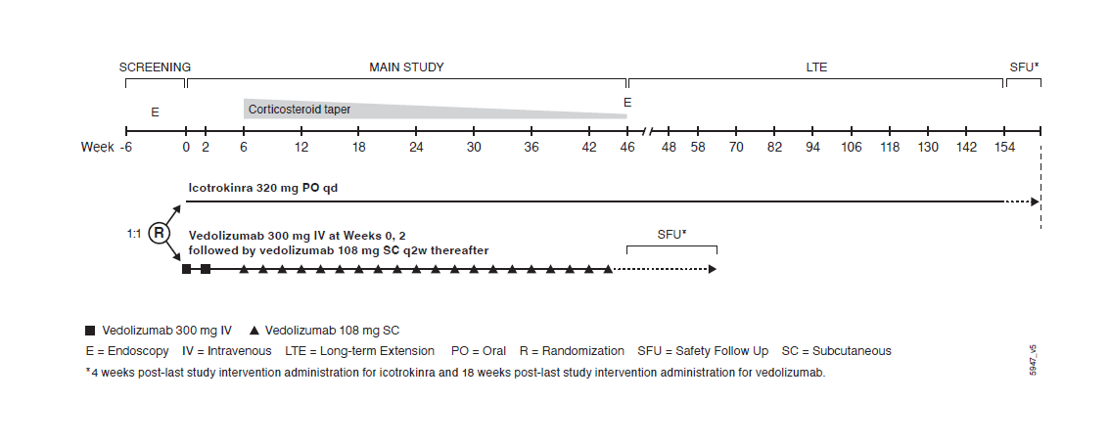
Study Design

Slide 20

Key Eligibility Criteria
UC Diagnosis
≥ 12 weeks prior to screening
Documented history of a complete colonoscopy during their disease course. Histopathology results supporting the diagnosis of UC, if unavailable, may be obtained during screening and interpreted locally
Clinically active UC
Baseline (Week 0) mMAYO score 5 - 9
Final Centrally read screening endoscopy subscore ≥2
Note: Participants with isolated proctitis at baseline are eligible and will be capped at 10% of the total population.
Proctitis is defined as colonic involvement spanning <10 cm from the dentate line and is determined via central review
Moderately to Severely Active UC

Slide 21

Key Eligibility Criteria
Screening Dysplasia Assessment
Participants with extensive UC for ≥8 years, or disease limited to the left side of the colon for ≥ 10 years before the first dose must undergo the following:
  A complete colonoscopy to assess for the presence of dysplasia within 1 year before the first dose. Screening local dysplasia assessment and pathology interpretation is allowed
  Participants with PSC must have complete colonoscopy with extensive biopsies for dysplasia screening within 1 year before the first dose regardless of the duration of UC disease history
Participants ≥45 y/o who do not meet criteria for dysplasia screening must undergo a complete colonoscopy to assess for the presence of adenomatous polyps within 5 years before the first dose. Remove adenomatous polyps if present.
Dysplasia Assessment

Slide 22
Key Eligibility Criteria
Inadequate response or failure to tolerate previous conventional therapy (ADT-naïve) or inadequate response (ie primary or secondary nonresponse) or failure to tolerate advanced therapy defined as biologics and/or advanced oral agents for the treatment of UC (ADT-IR):
Advanced Therapy (ADT-IR)
Anti - TNFα
(ie, infliximab, adalimumab, golimumab, or biosimilars)
Anti-interleukin 12/23(p40)
ie, ustekinumab or biosimilars
JAK inhibitors
ie, tofacitinib, upadacitinib, filgotinib
S1P receptor modulators
ie, ozanimod, etrasimod
Conventional Therapies (ADT-naïve)
Oral or IV/IM corticosteroids
Thiopurines (i.e AZA, 6-MP, Thioguanine)
Medication Capping
Inadequate response or intolerance to ≥3 approved ADT (agents): 15% of ADT-IR
    Note: Biosimilars count as the same ADT
Inadequate response or intolerance to ustekinumab: 20% of ADT-IR

Slide 23
Key Eligibility Criteria
A participant must adhere to all of the following requirements for medications for the treatment of UC. The following medications are permitted provided that doses meeting the requirements listed below are stable or have been discontinued prior to baseline (Week 0) within the timeframes specified below:
    a. Oral 5-ASA compounds on stable doses for at least 2 weeks; or if recently discontinued, must have been stopped for at least 2 weeks.
    b. Oral corticosteroids at a prednisone-equivalent dose at or below 20 mg/day, or up to 9 mg/day of budesonide, or 5 mg/day of beclomethasone dipropionate, and on stable dosing for at least 2 weeks; or if recently discontinued, must have been stopped for at least 2 weeks.
    c. Immunomodulators (ie, AZA, 6-MP, or MTX) for at least 12 weeks and have been on a stable dose for at least 4 weeks; or if recently discontinued, must have been stopped for at least 4 weeks.

Slide 24
Key Eligibility Criteria - Prior Medication Washout Periods
Medication |  | Minimum Washout Period prior to baseline (Week 0)
JAK inhibitors (e.g. tofacitinib, upadacitinib, or filgotinib) |  | 2 weeks
Ozanimod or other S1P receptor modulators |  | 4 weeks (must have lymphocyte count >0.4×10³/μL at screening)
Biologic Agents (or their biosimilars) Anti-TNFα | infliximab | 3 weeks | Shorter washout duration is acceptable based on undetectable drug levels from an approved commercially available local test The initiation or continuation of an ADT during screening is prohibited.​
 | adalimumab, golimumab | 4 weeks
ustekinumab |  | 5 weeks
IL-23p19 (guselkumab, mirikizumab, risankizumab) IL-23R inhibitors (including icotrokinra) |  | Any prior exposure is excluded
Approved or investigational anti-integrins (eg, vedolizumab, natalizumab, efalizumab, etrolizumab, AMG 181, carotegrast methyl), or anti‑MAdCAM-1 antibodies |  | Any prior exposure is excluded

Slide 25
Key Eligibility Criteria - Prior Medication Washout Periods
Medication | Minimum Washout Period prior to baseline (Week 0)
Rectal 5 ASA compounds | 2 weeks
Cyclosporine, tacrolimus, sirolimus or mycophenolate mofetil received | 4 weeks
Thioguanine | 4 weeks
Other immunomodulatory agents, including approved and investigational biologic and non biologic agents | 12 weeks or 5 half‑lives (whichever is longer)
Rectal corticosteroids, IV/IM corticosteroids | 2 weeks, 3 weeks
Antibiotics for the primary treatment of UC | 2 weeks
Parenteral nutrition | 2 weeks
Apheresis | 3 weeks
Fecal microbiota transplantation or any live bacterial therapeutic agent | 12 weeks
Agents that deplete B or T cells | 24 weeks
Non-autologous stem cell therapy | 1 year
Any other investigational intervention | 4 weeks or 5 half-lives (whichever is longer)

Slide 26
Ideal Site Profile
Specialty │ Site Type | PI specialty Gastroenterology, if not, Sub-I specialty must be Gastroenterology University, hospital-based or standalone, community-based practices IBD Clinic, GI Clinic/Digestive Clinic, Research Center
Experience │ Capability | Phase 2 or 3 IBD clinical trial experience With recent J&J IBD experience preferred, prioritizing high enrolling sites Experience performing efficacy procedures/assessments, i.e., Full/Modified/Partial Mayo score Video endoscopy (histology assessments) Inflammatory PD markers (CRP and fecal calprotectin) PRO measures to assess symptom severity, functioning, and HRQoL including AP-NRS, IBDQ, PROMIS 29, and PROMIS Fatigue Short Form 7a
Operational Considerations | Access to large pool of patients with moderately to severely active Ulcerative Colitis who are naïve to advanced therapies (ADT-naïve) and who had an inadequate response or failure to tolerate biologics or oral small molecule therapies (i.e., ADT-IR) Access to patients without prior exposure to anti-IL23p19 antibodies or compounds targeting the IL-23R. Access to patients without prior exposure to vedolizumab. ADT-IR will comprise a minimum of approximately 40% and a maximum of approximately 50% of the population. The proportion of participants with inadequate response (ie primary or secondary nonresponse) or intolerance to ≥3 approved advanced therapies (agents, not number of classes) as listed above (in biologic or oral advanced therapies section) will be limited to 15% of the ADT-IR population. The number of participants with inadequate response (ie primary or secondary nonresponse) or intolerance to ustekinumab will be capped at 20% of the ADT-IR population.

Slide 27
Feasibility

Slide 28
Latest Assumptions on ICONIC UC H2H Trial
The strong momentum from ANTHEM UC and Phase 3 ICONIC UC is expected to continue in the ICO UC H2H study
ICONIC UC H2H study | *Baseline scenario
N | 652
Patient Population | Patients with moderate to severe ulcerative colitis Exclusion of participants with prior exposure to compounds targeting IL‑23 p19 (guselkumab, mirikizumab, risankizumab) or IL-23R (icotrokinra), and/or integrins (vedolizumab) narrows the eligible population (bio‑naïve, TNFα antibodies, ustekinumab, JAK inhibitors, SIP receptor modulators and their biosimilars), potentially limiting country footprint and slowing recruitment.
Sites | ~300
Countries | TBD
Enrollment period | ~11 Months
Recruitment rates | ~0.16 - 0.18 psm
FSO/FPI | FSO: Mid Jan 2027 FPI: 02 Feb 2027

Slide 29
Assumptions and Considerations
Based on ANTHEM UC and ongoing Phase 3 ICONIC UC experience, the ICO UC H2H study is expected to achieve accelerated enrollment, with recruitment rates of 0.16–0.18 patients/site/month.
The active‑comparator design (icotrokinra vs vedolizumab), absence of placebo, and strong value proposition are expected to drive high site and patient engagement, supporting enrollment performance comparable to or slightly faster than ANTHEM UC and the Phase 3 ICONIC UC trial.
However, the patient population will be more narrowed from ICONIC UC and may present some unknowns to recruitment:
  Exclusion of participants with prior exposure to compounds targeting IL‑23 p19 (guselkumab, mirikizumab, risankizumab) or IL-23R (icotrokinra), and/or integrins (vedolizumab) narrows the eligible population (bio‑naïve, TNFα antibodies, ustekinumab, JAK inhibitors, SIP receptor modulators and their biosimilars)
Biggest risk remains: no prior performance data in this precise patient population with exclusion of those exposed to vedolizumab. To mitigate for this risk, the global footprint being assessed may offer a balance of opportunities.

Slide 30
Country Selection Criteria
A balance of countries with rich JNJ IBD experience and those without vedolizumab in broad use
The list of 35 countries in the following slide includes a mix of markets with varying potential.
Given the broad availability of vedolizumab, it is expected that a country footprint reflecting a balance of the following will be most successful in supporting the H2H:
Vedo not approved or broadly available
Bio-IR pt pop high, suggesting high unmet need for sicker pts
Bio-IR pt pop high, ADTs limited
JNJ experience in ~50%
Bio-naïve pt population suggesting lower vedo exposure
The team will also be exploring countries with:
Quick start up practices
Proven track record in recruitment

Slide 31
Executive Snapshot of Country Outreach Feedback
Strong interest, mixed vedo insurance coverage – signaling recruitment potential; however max potential is underwhelming such that a broad footprint may be required
All 35 countries express interest in participating in this H2H.
On a scale of 1 – 5 with 5 being the greatest interest, the average reporting interest is 4.7. Estonia and Singapore report an interest level of 3.
34/35 countries report vedo being approved in their country, though this does not necessarily mean marketed but registered (Estonia reports no)
21 countries report vedo is fully covered by insurance but under strict conditions or only covered for 52 weeks in one case (Taiwan)
14 countries report partial coverage, no coverage or limited availability
19 countries report anticipated competition during the enrollment period
A total of 474 – 861 subjects and 241 – 388 sites estimated to support this trial
Avg Pt/Site=2

Slide 32
Country Patient/Site estimates per Country Outreach
Country | Min Sites | Max Sites | Min Pts | Max Pts -- filtered
Poland | 12 | 30 | 36 | 140
Brazil | 16 | 21 | 50 | 65
India | 10 | 12 | 32 | 40
United States | 34 | 64 | 23 | 38
France | 10 | 12 | 20 | 36
China | 14 | 21 | 17 | 30
Germany | 8 | 14 | 14 | 30
Hungary | 10 | 12 | 24 | 30
Mexico | 10 | 14 | 20 | 30
Romania | 6 | 10 | 18 | 30
Thailand | 7 | 10 | 20 | 30
Czech | 8 | 10 | 16 | 27
Israel | 8 | 10 | 20 | 25
Slovakia | 6 | 9 | 12 | 25
South Africa | 6 | 8 | 18 | 24
Switzerland | 3 | 8 | 9 | 24
Japan | 8 | 10 | 15 | 20
Saudia Arabia | 4 | 6 | 13 | 20
Serbia | 4 | 7 | 10 | 20
Bulgaria | 6 | 10 | 10 | 18
Canada | 6 | 10 | 9 | 18
Malaysia | 4 | 6 | 12 | 16
Turkey | 5 | 9 | 8 | 15
Argentina | 6 | 10 | 10 | 14
Peru | 2 | 7 | 2 | 14
Philippines | 5 | 6 | 5 | 12
Australia | 4 | 8 | 5 | 10
Latvia | 3 | 5 | 5 | 10
Lithuania | 2 | 5 | 4 | 10
Estonia | 2 | 4 | 4 | 8
Slovenia | 1 | 3 | 3 | 8
Taiwan | 4 | 5 | 4 | 8
Croatia | 3 | 4 | 2 | 6
New Zealand | 2 | 5 | 2 | 5
Singapore | 2 | 3 | 2 | 5
TOTALS | 241 | 388 | 474 | 861
NEED | 300 |  | 652
30+ subjects max estimated; 26 minimum average
With a minimum of 474 and only a max of 861 patients estimated to participate, site outreach should include a broad footprint to further validate the potential in these countries
Between 10 – 27 max subjects estimated; 11 minimum average
Minimal contribution estimated

Slide 33
Country Feasibility Snapshot across key criteria
Country | ADT naïve pts | Country FSO | Internal competition concern | PTA requirement | Coverage | Min sites | Max sites | Min pts | Max pts
Argentina​ |  |  |  |  |  | 6 | 10 | 10 | 14
Australia​ |  |  |  |  |  | 4 | 8 | 5 | 10
Brazil​ |  |  |  |  |  | 16 | 21 | 50 | 65
Bulgaria |  |  |  |  |  | 6 | 10 | 10 | 18
Canada​ |  |  |  |  |  | 6 | 10 | 9 | 18
China​ |  |  |  |  |  | 14 | 21 | 17 | 30
Croatia |  |  |  |  |  | 3 | 4 | 2 | 6
Czech​ |  |  |  |  |  | 8 | 10 | 16 | 27
Estonia |  |  |  |  |  | 2 | 4 | 4 | 8
France |  |  |  |  |  | 10 | 12 | 20 | 36
Germany |  |  |  |  |  | 8 | 14 | 14 | 30
Hungary​ |  |  |  |  |  | 10 | 12 | 24 | 30
India​ |  |  |  |  |  | 10 | 12 | 32 | 40
Israel​ |  |  |  |  |  | 8 | 10 | 20 | 25
Japan​ |  |  |  |  |  | 8 | 10 | 15 | 20
Latvia |  |  |  |  |  | 3 | 5 | 5 | 10
Lithuania |  |  |  |  |  | 2 | 5 | 4 | 10
Malaysia​ |  |  |  |  |  | 4 | 6 | 12 | 16
Mexico​ |  |  |  |  |  | 10 | 14 | 20 | 30
New Zealand​ |  |  |  |  |  | 2 | 5 | 2 | 5
Peru |  |  |  |  |  | 2 | 7 | 2 | 14
Philippines |  |  |  |  |  | 5 | 6 | 5 | 12
Poland​ |  |  |  |  |  | 12 | 30 | 36 | 140
Romania​ |  |  |  |  |  | 6 | 10 | 18 | 30
Saudia Arabia |  |  |  |  |  | 4 | 6 | 13 | 20
Serbia |  |  |  |  |  | 4 | 7 | 10 | 20
Singapore* |  |  |  |  |  | 2 | 3 | 2 | 5
Slovakia |  |  |  |  |  | 6 | 9 | 12 | 25
Slovenia |  |  |  |  |  | 1 | 3 | 3 | 8
South Africa​ |  |  |  |  |  | 6 | 8 | 18 | 24
Switzerland​ |  |  |  |  |  | 3 | 8 | 9 | 24
Taiwan​ |  |  |  |  |  | 4 | 5 | 4 | 8
Thailand​ |  |  |  |  |  | 7 | 10 | 20 | 30
Turkey​ |  |  |  |  |  | 5 | 9 | 8 | 15
United States |  |  |  |  |  | 34 | 64 | 23 | 38
While recruitment opportunities may be limited in some countries, it's important to assess site potential further given other factors including faster start up, limited competition, no PTA requirement and ability to recruit ADT naïve patients

Slide 34
Site List Development Process & Customized Flags

Slide 35
High Level Site List Development Process
Site Recommendation
Key Process Steps
  Feasibility Kick-off & Strategy Alignment
  Data Extraction & Mastering
  Predictive Site Recommendation
  via AI/ML Models
  Metric Calculations
  & Tiering
  End-to-End Feasibility Oversight
Align on strategy and approach with core team members
Extract and master multimodal data from various sources incl. qualitative inputs
Create a central site universe that incorporates site predictions based on AI/ML models
Calculate site & investigator metrics to tier sites and create a recommended site list
Continued support and guidance from site activation
to patient enrollment
Key Outputs
01
02
03
Raw Data Driven Site List
Data Driven Site List (DDSL)
Recommended Site List
Preliminary integrated source of all potential sites identified through various data sources, recommendations from TA, MAF, GCO, CRO etc.
A tiered Data Driven Site List evaluated through one or more approaches, including Med.ai Site Selection AI/ML model, RWE AI/ML model, and/or customized tiering/indexing
Site List that results from market input and endorsement of sites selected from the DDSL, contained within the Site Decision List (SDL)

Slide 36








Data Driven Site List Elements
Site lists are developed through multi-faceted means combining internal and external historical data (benchmarks) paired with innovative AI/ML models to ensure that best sites.
  Internal Benchmarking & Competitive Studies
  External Benchmarking & Competitive Studies
  Site Prediction
  Models (COP and SST)
  Real-World
  Model
  Diversity
  Model
  Assess site performance & experience for Janssen studies
  Assess site performance & experience for non-Janssen studies
  Identify sites with high enrollment potential and low likelihood of default
  Assess patient volumes & enrollment potential at HCO/HCP level to identify sites fitting the cohort profile
  Assess potential of sites likely to enroll patients from underrepresented populations based on geographic and patient diversity.
  Source:
  Source:
  Source:
  Source:
  Source:
iAWARE

Slide 37
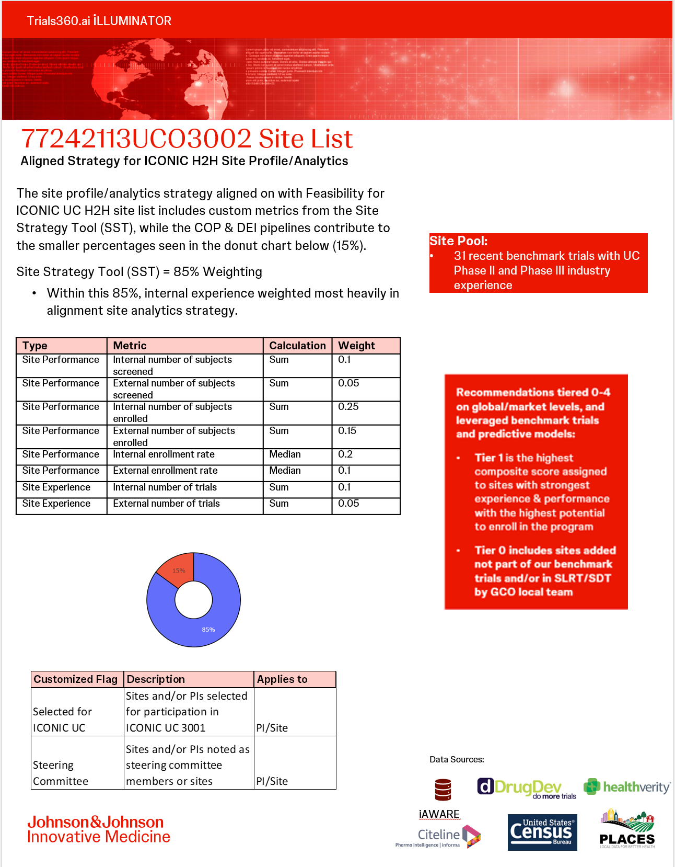

Slide 38
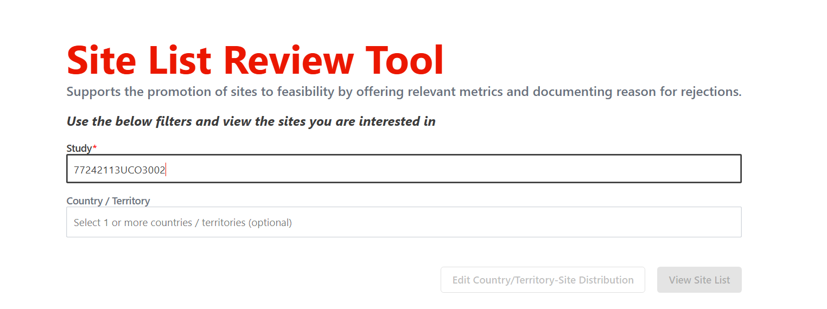
SLRT Country-Site Distribution
Sites required* in SLRT has been pre-determined to allow start of site list review (*number sites to be approached in the site outreach)
In some countries the SLRT has far more sites than are needed, since these are all the sites associated with the benchmark studies (including multiple PIs when a site has more than one associated).
We also have all available countries (not all countries are to proceed with feasibility assessment)
Local country expert knowledge is essential for reviewing the most appropriate sites for feasibility assessment.
The list of available sites can be filtered in multiple ways:
  Tiering (based on historical performance)
  Iconic UC sites
  Steering Committee Members
Country | GCO estimated Max # Sites | Count Unique Sites in SLTR | Count Sites in SLRT | #Sites Required in SLRT
Argentina | 10 | 32 | 35 | 30
Australia | 8 | 35 | 52 | 24
Brazil | 21 | 80 | 97 | 63
Bulgaria | 10 | 30 | 32 | 30
Canada | 10 | 30 | 42 | 30
China | 21 | 63 | 95 | 63
Croatia | 4 | 15 | 18 | 12
Czech Republic | 10 | 32 | 37 | 30
Estonia | 4 | 6 | 9 | 12
France | 12 | 41 | 65 | 36
Germany | 14 | 46 | 71 | 42
Hungary | 12 | 37 | 61 | 36
India | 12 | 45 | 52 | 36
Israel | 10 | 22 | 42 | 30
Japan | 10 | 40 | 63 | 30
Latvia | 5 | 10 | 12 | 15
Lithuania | 5 | 6 | 7 | 15
Malaysia | 6 | 19 | 24 | 18
Mexico | 14 | 42 | 43 | 42
New Zealand | 5 | 10 | 12 | 15
Peru | 7 | 7 | 7 | 21
Philippines | 6 | 5 | 5 | 18
Poland | 30 | 90 | 118 | 90
Romania | 10 | 30 | 38 | 30
Saudi Arabia | 6 | 5 | 5 | 18
Serbia | 7 | 16 | 22 | 21
Singapore | 3 | 5 | 5 | 9
Slovakia | 9 | 25 | 30 | 27
Slovenia | 3 | 4 | 5 | 9
South Africa | 8 | 28 | 31 | 24
Switzerland | 8 | 9 | 12 | 24
Taiwan | 5 | 10 | 16 | 15
Thailand | 10 | 8 | 8 | 30
Turkey | 9 | 29 | 41 | 27
United States | 64 | 192 | 300 | 192
Total | 388 | 1104 | 1512 | 1164
Subject to change per GCO feedback
        Additional sites can be added manually in SLRT (and SDT)

Slide 39
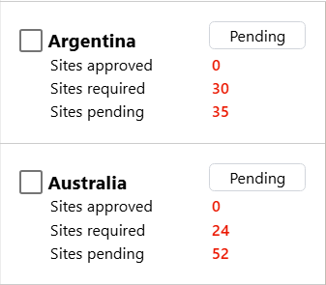
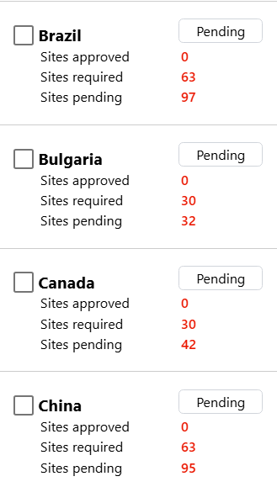
SLRT Country-Site Distribution
Subject to change per GCO feedback
If SLRT access is required, please complete and fill in your details in the ​​
Sites required* in SLRT has been pre-determined to allow start of site list review (*number sites to be approached in the site outreach)
Depending on local team decision, #sites required in SLRT could be modify
- Send request to Feasibility Manager Jenifer Eche
To confirm that your review has been completed, country status should change to “Ready for Feasibility” from “Pending”
77242113UCO3002_SLRT_SDT Access Request Form.xlsx

Slide 40
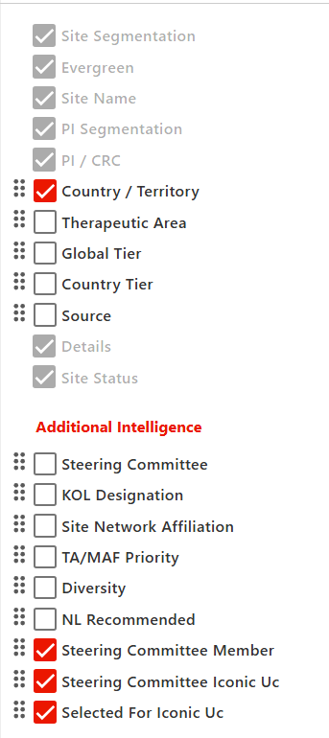
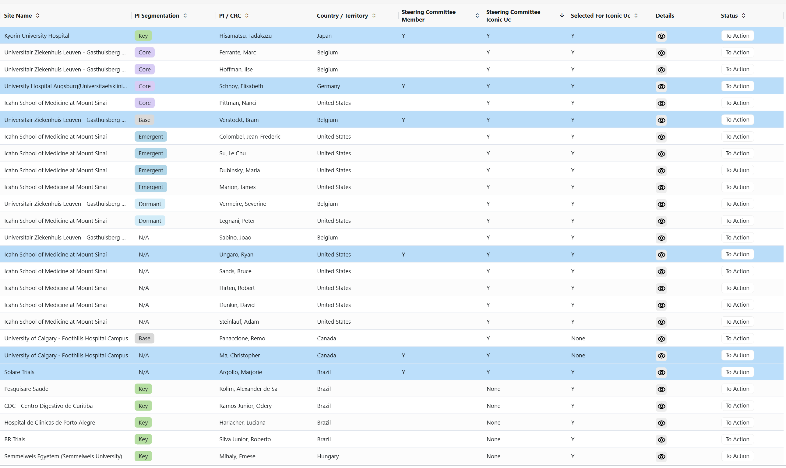
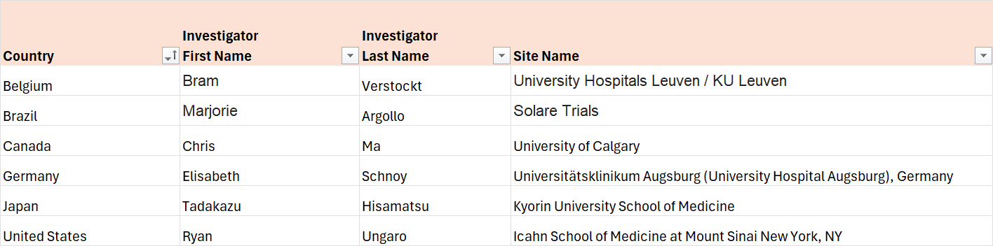
SLRT Specific Flags
Sites/Investigators from ICONIC UC (77242113UCO3001)
Sites participating in ICONIC UC have been:
  Added to SLRT
  Flagged as “Selected for ICONIC UC” in SLRT
Steering Committee Members
Six Investigators participating in Steering Committee have been:
  Added to SLRT
  Flagged as “Steering Committee Member” in SLRT
Investigator Level Flag
Site Level Flag
SLRT Flagging Reminder:
In case new records are created, please ensure all applicable sites and investigators are correctly flagged

Slide 41
SipIQ /SDT Process Overview and Next Steps

Slide 42
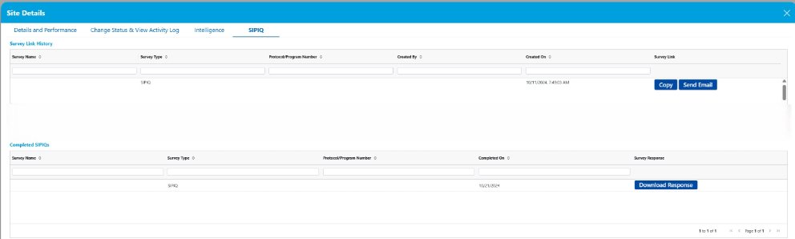
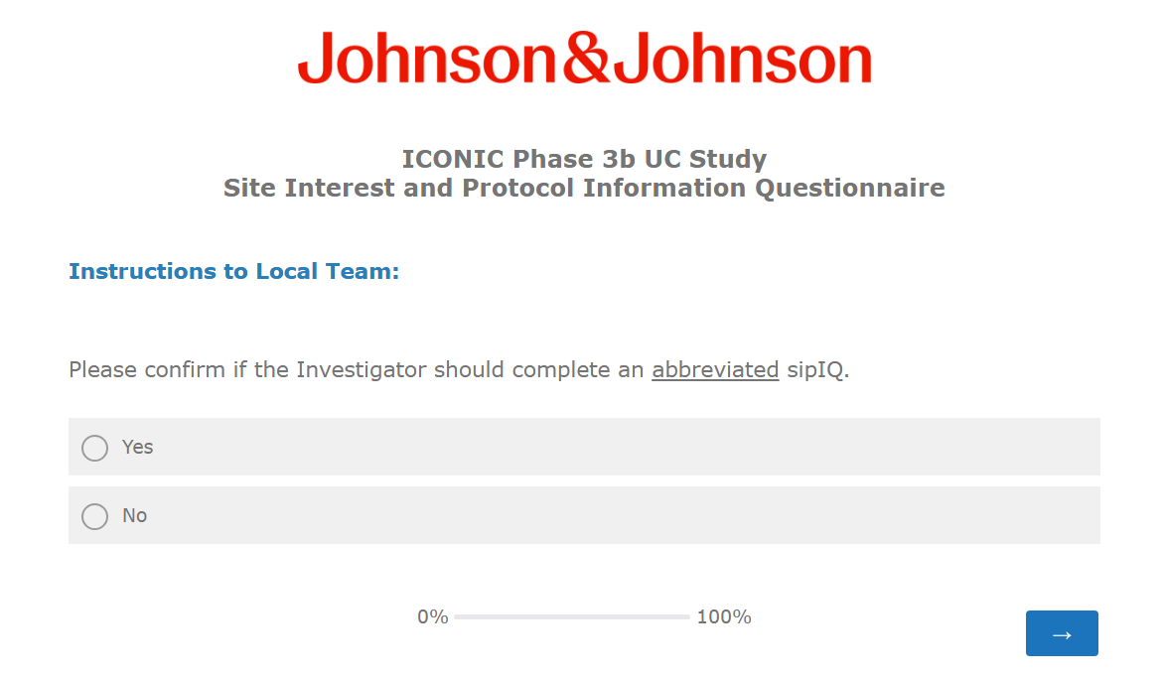
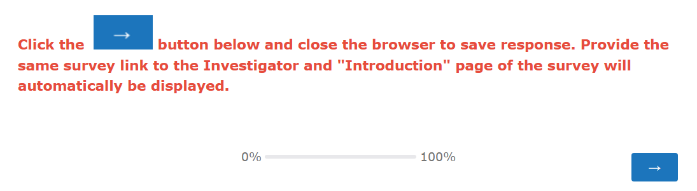
Site Interest and Protocol Information Questionnaire (sipIQ)
Strategy
Option to offer site to complete and Abbreviated or Full sipIQ ​
Local team will have the ability to assign an abbreviated sipIQ to Investigators involved in J&J UC studies
Step 1: Access the generated sipIQ link. Confirm the survey type and follow instruction as seen below
sipIQ link to be generated via Site Decision Tool (SDT) in Illuminator

Slide 43
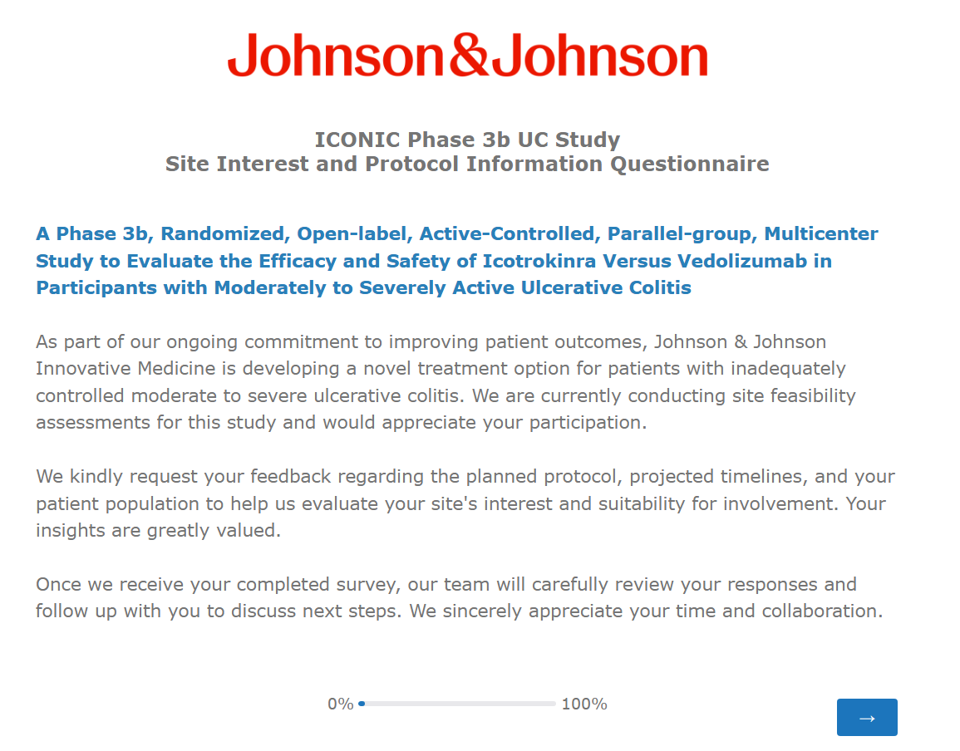
Site Interest and Protocol Information Questionnaire (sipIQ) ​
Abbreviated or Full sipIQ
Local Team to complete:
Page that the Investigator will see accessing the link:
Choose the right answer. Once you proceed to the next page, you cannot go back.
Back button was disabled to prevent Investigator to inadvertently change the type of survey to be completed.

Slide 44
Site Interest and Protocol Information Questionnaire (sipIQ) ​
Content
Abbreviated sipIQ
Full sipIQ​
Introduction
Contact Information
Confidentiality Statement
Interest
Protocol Requirements
Patient Population
Enrollment
Site Experience and Staffing
Equipment and Facility Requirements
Institutional Review Board, Ethics Committee, and Contracts
Patient Demographics Overview
Operational Considerations
Comments
Introduction
Contact Information
Confidentiality Statement
Interest
Protocol Requirements
Enrollment
Patient Demographics Overview
Operational Considerations
Comments
Guidance to Local Team to determine if abbreviated sipIQ is applicable
If J&J has worked with the Principal Investigator during the previous 12 months
- at the same location/address
- in the same indication (UC)
- and the site enrolled subjects

Slide 45
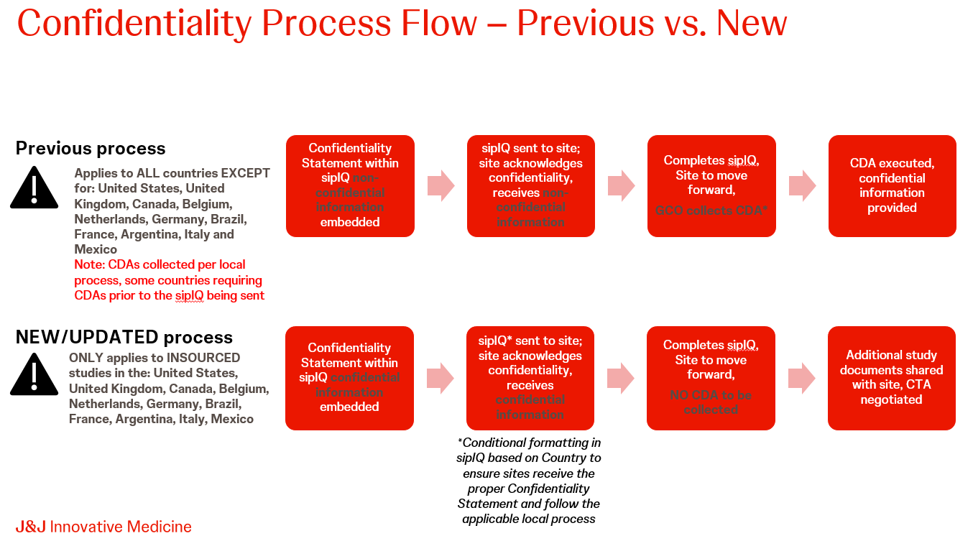
Site Interest and Protocol Information Questionnaire (sipIQ)
Confidentiality Process
Updated Confidentiality Process in sipIQ
Applicable for: United States, United Kingdom, Canada, Belgium, Netherlands, Germany, Brazil, France, Argentina, Italy and Mexico
The confidentiality statement within the sipIQ has been updated to allow teams to share confidential information at the time of sipIQ deployment.
Sites accept our confidentiality statement in the sipIQ. If the statement is accepted, a CDA with the site is not required.
This new process bypasses the need for a fully executed CDA to be collected for Feasibility through to CTA negotiations
This is not an electronic CDA.
The sipIQ response is then filed in place of a fully executed CDA for sites that accept.

Slide 46
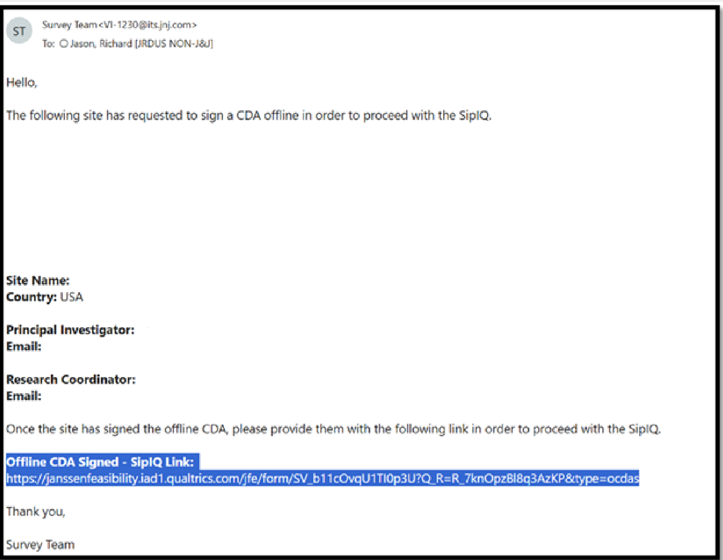
Site Interest and Protocol Information Questionnaire (sipIQ)
Offline CDA Email Alert and Distribution List
Example Offline CDA email alert
Country | Offline CDA Recipient(s)
Argentina | zpatrign@its.jnj.com
Brazil | GCompian@ITS.JNJ.com
Canada | tresuell@its.jnj.com
France | FLeThoma@ITS.JNJ.com KBourlot@ITS.JNJ.com
Germany | GCO-DACH- CDAs@jnj.onmicrosoft.com
Mexico | vcastan4@its.jnj.com
United States | RNDUS-LD-Insourced_Studies-CDA@its.jnj.com JNowak2@ITS.JNJ.com
A Phase 3b, Randomized, Open-label, Active-Controlled, Parallel-group, Multicenter Study to Evaluate the Efficacy and Safety of Icotrokinra Versus Vedolizumab in Participants with Moderately to Severely Active Ulcerative Colitis
Action: In case additional LTMs needed to be added, please notify Jenifer Eche

Slide 47
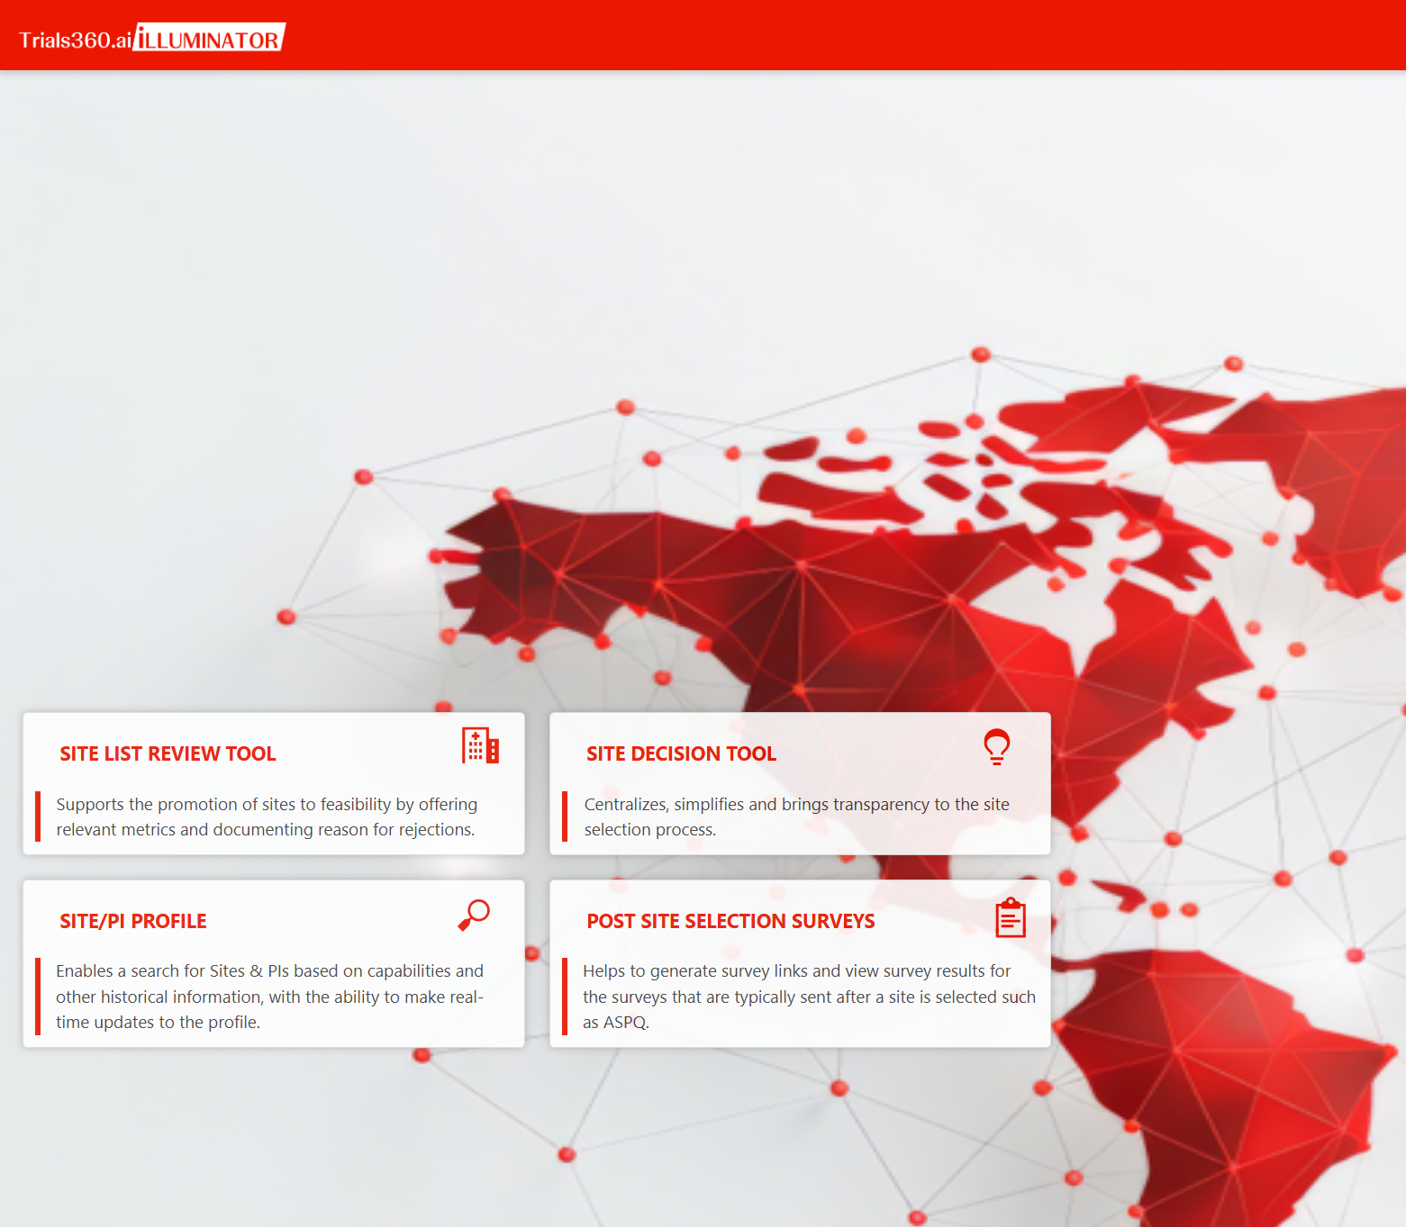
iLLUMINATOR
To help you get ready to use iLLUMINATOR- SLRT and SDT modules, please review the custom learning resources below to learn how to use iLLUMINATOR and to understand its benefits.
iLLUMINATOR SharePoint Portal
FAQs
Site List Review Tool (SLRT):
Site List Review Tool Learning Resources
Site Decision Tool (SDT):
Site Decision Tool's in-app training demo videos
​​​​​​iLLUMINATOR Site Decision Tool_User Journey.pdf
​​​​​​iLLUMINATOR SDT Workflow Legends.pdf

Slide 48
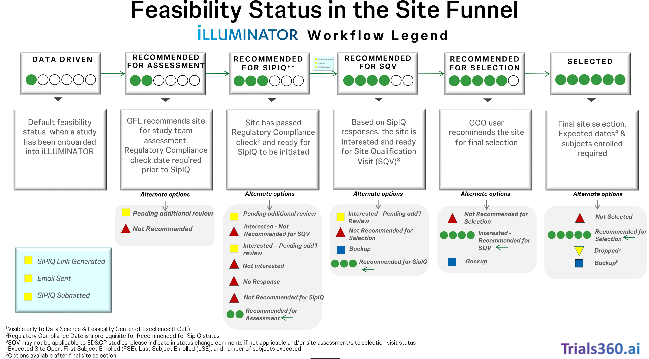
Site Decision Tool (SDT) - iLLUMINATOR
auto status change when sipIQ submitted in Qualtrics but site status must be at “EMAIL SENT”

Slide 49
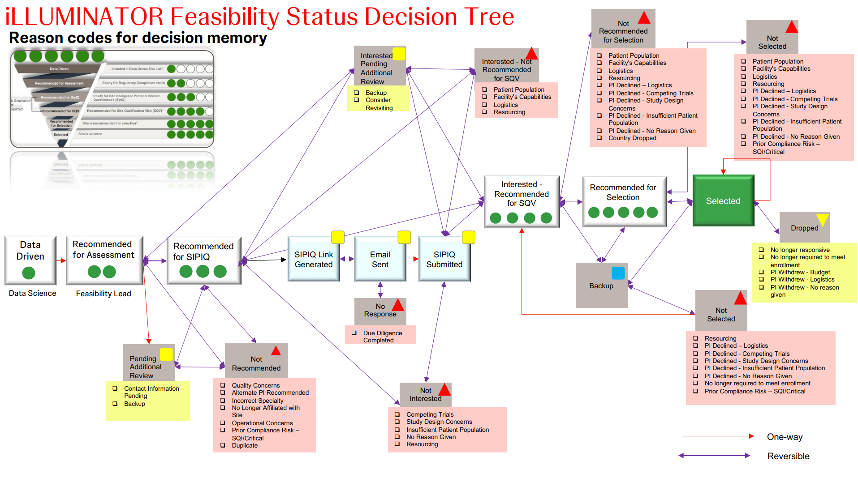

Slide 50


Next Steps
SLRT
If need to adjust SLRT Sites Required – contact Jenifer Eche
Initiate site review and perform actions required
SDT
You will be notified once the sites move to SDT
To confirm that your review has been completed, country status should change to “Ready for Feasibility”
Generate sipIQ link in SDT and send to sites
Review completed sipIQ and determine if the site is to be recommended for SQV
Monitor and follow up sites
Countries with “Completed” status in SLRT - sites will be moved to SDT
Start: 19 May 2026
End of Site Outreach: 30 June 2026
Survey Materials:
PDF copy of sipIQ
Sample cover letter
Copy of embedded protocol summary
Qualtrics access guide and login information
IP Attorney CDA Review Form​
Ongoing basis (~1 week review turn around time)
Check if you have SLRT edit access. Any issues, contact Jenifer Eche

Slide 51
Timelines
Action​ | Timing
SipIQ Kick off and activities, including site list review | 19May2026
SLRT and Site Outreach launch | 19May2026
Final Protocol | End of June
Site Outreach (sipiq) to be completed | 30Jun2026
List of Countries to proceed to SQV | Mid July 2026
SQV Training and SQVs to be conducted | 17 June 2026 Training; July – Aug SQVs
GCO to make recommendations on site selections | Following completion of SQVs
GCO to provide final commitments (# sites/# of pts per country) | Late Aug 2026
Final Site List | Aug 2026
Baseline Lock​​​ | ~December 2026
FSO/FPI​​​c | February 2027
We are HERE
Notes:
EU CTR submission plan: Oct 2026 but potentially earlier

Slide 52

THANK YOU!
WBS Time Reporting:
T900007630

Slide 53
Back up

Slide 54
Country List Generation
GCO and MAF Regional / Local Feedback
(via community leads)
Trends / Regulatory
expectations
INITIAL STARTING COUNTRY LIST
Performance Data
Developed as Input to Early Planning Scenarios
Defined by cross-functional team at DU DAS ELT level. Leverages program/project KEM views, disease landscape, patient journeys, performance and other data. Should consider, prioritization, local resourcing, and country utilization to ensure portfolio is balanced and delivered. Will be sufficiently broad to mitigate scope changes and local / strategic shifts.
COUNTRIES FOR OUTREACH
Country Outreach Scenarios
GFLS Assessment 1
Developed as Output of Country Outreach Scenarios
Incorporates cost/performance data captured in country outreach scenarios, in combination with feedback from CSC, Clinical, GCSO, GFLS and GCO community leaders
Step 2: PI / Site Profiles, Steer-co, KOLs, D&I Goals
Step 3: CSC, GCSO, GCO, MAF insights
COUNTRIES FOR SITE OUTREACH
Country Outreach Data and Validated Ranges
Developed as Output of Site Outreach Scenarios
Leverages site / patient ranges validated by local teams during country outreach.
Timeline Endorsement and Site outreach scenarios
Latest program & Study Strategies
FINAL COUNTRY LIST
Refined commitment from countries
Site selection proposals and distribution of sites
Developed as Output of Baseline Lock Scenario
Necessary refinements made to countries for site outreach based on commitments from countries, site selection proposals and any protocol/GFLS or other updates.
protocol, GFLS or country/site updates
54

Slide 55
UC H2H benchmarks: Review
There are limited recently completed H2H trials in moderate to severe UC
Trial Title | Trial Phase | Trial Status | Enrollment Duration | P/S/M | Target N | Sites | P/S | Countries | Pts/Country
A Phase 3b, Randomized, Double-Blind, Parallel-Arm, Placebo- and Active- Controlled Treat-Through Study of Mirikizumab and Vedolizumab in Participants With Moderately to Severely Active Ulcerative Colitis, Eli Lilly | III | Terminated | 31.8 | 0.15 | 1100 | 236 | 4.7 | 34 | 32
A Randomized, Double-blind, Multicenter Phase 3 Study in Patients With Moderately to Severely Active Ulcerative Colitis (UC) to Compare the Efficacy, Safety and Immunogenicity of PB016 and Entyvio® for the Induction and Maintenance of Clinical Response and Remission, Polpharma | III | Open | 23.8 | 0.16 – TBD | 750 | 200 | 3.8 | 17 | 44
Parallel-Group Treatment, Double-Blind, 2-Arm to Investigate Comparative Efficacy Safety Immunogenicity Between Intravenous AVT16 and Entyvio® in Male and Female Subjects 18 to 80 Years Inclusive, Moderate to Severe Ulcerative Colitis, Alvotech | III | Open | 16.7 | TBD | 748 | 100 | 7.5 | 17 | 8
Phase 3b, Multicenter, Randomized, Open-Label Study of Risankizumab Compared to Vedolizumab for the Treatment of Adult Subjects With Moderate to Severe Ulcerative Colitis Who Are Naïve to Targeted Therapies, AbbVie | III | Open | 27.9 | 0.07 – TBD; 0.09 as of Jan26 | 530 | 285 | 1.9 | 29 | 18
Comparison of Medical RESCUE Strategies for Patients With Steroid-refractory Acute Severe Ulcerative Colitis: an Open-label Randomized Controlled Trial (RESCUE-UC).AbbVie | III | Planned | 20.0 | TBD | TBD | TBD | TBD | TBD | TBD
Trial | Countries in most recent or ongoing UC H2Hs
Eli Lily | Argentina; Australia; Austria; Belgium; Brazil; Canada; Croatia; Czech Republic; Denmark; France; Germany; Hungary; India; Italy; Japan; Latvia; Lithuania; Malaysia; Mexico; Netherlands; Poland; Portugal; Romania; Russia; Serbia; Slovakia; South Africa; South Korea; Spain; Switzerland; Turkey; Ukraine; United Kingdom; United States
Polpharma | Albania; Australia; Bosnia and Herzegovina; Brazil; Bulgaria; Czech Republic; Georgia; Hungary; India; Israel; Latvia; Moldova Republic; Poland; Romania; Slovakia; South Africa; Turkey
Alvotech | Argentina; Bosnia and Herzegovina; Bulgaria; Colombia; Croatia; Georgia; India; Italy; Latvia; Mexico; Peru; Poland; Romania; Serbia; Slovakia; Sri Lanka; Ukraine
AbbVie | Austria, Brazil, Bulgaria, Canada, China, Croatia, Estonia, Finland, Germany, Hungary, Ireland, Israel, Italy, Latvia, Lithuania, Mexico, Netherlands, Poland, Puerto Rico, Saudi Arabia, Slovenia, South Korea, Spain, Sweden, Switzerland, Taiwan, United Arab Emirates, United Kingdom, United States
AbbVie | Not yet available
In green, countries overlap with current country list for country outreach

Slide 56
Benchmark insights:
Phase 2/3 and 3 UC Industry Sponsored Trials, last 5 years, N=16
Patient availability informs country and site needs
Percentiles | Sites | Countries | Pts/Site Capacity | Pts/Site/Month | Enrollment Duration
P10 | 167.50 | 24.0 | 0.81 | 0.04 | 14.42m
P25 | 199.25 | 26.8 | 0.86 | 0.05 | 21.15m
P50 | 424.50 | 36.5 | 1.21 | 0.07 | 24.47m
P75 | 486.50 | 40.0 | 1.78 | 0.09 | 31.30m
P90 | 544.50 | 46.0 | 2.74 | 0.11 | 43.84m
Average | 370 | 35 | 1.5 | 0.07 | 27m
Internal Trial | Sites | Countries | Pts/Site Capacity | Pts/Site/Month | Enrollment Duration
Anthem UC (N=240) | 200 | 22 | 1.2 | 0.15 | 8m
ASTRO (N=418) | 310 | 29 | 1.5 | 0.11 | 18.3m
DUET UC (N=550) | 491 | 49 | 1.1 | 0.07 | 20m
QUASAR (N=1000) | 524 | 36 | 2.0 | 0.08 | 35m

Slide 57








IBD External Competitive Landscape
Ulcerative Colitis snapshot
JNJ’s Competitive Edge is Steadfast
No other program includes an IL-23 target oral peptide, making JNJ4804 and JNJ2113 programs uniquely and well positioned.
Of phase 2/3 and 3 UC trials: need to update
27 open and/or planned global trials
  20 open; 7 planned
  ~15 trials expected to be active at JNJ2113 FSO
Key competitors | Drug/s | Target
Eli Lilly | Mirikizumab | IL-23 antagonist
Pfizer | ritlecitinib | JAK inhibitor
BMS | Ozanimond | Sphingosine 1-phosphate 1 receptor agonist; Sphingosine 1-phosphate 5 receptor agonist
Abivax | Obefazimod | HIV rev inhibitor; MicroRNA stimulant
AbbVie | Upadacitinib | JAK inhibitor
Roche | PF-06480605 | TNF superfamily member 15
Merck | Tulisokibart | Tumour necrosis factor ligand 1A antagonist; Immune checkpoint stimulant
Takeda | vedolizumab | Immunosuppressant; Alpha4beta7 integrin antagonist

Slide 58
UC Competitive Launch Timeline
Marketed
2025
2026
2027
2028
2029
2030
2031
2032+
JAK
Xeljanz, Rinvoq, Jyseleca (EU-only)
Ritlecitinib
Pfizer: P2 (Q4’28)
S1P
Zeposia, Velsipty
VTX-002
Ventyx: P2 (1H’29)
Orals
TAK-279
Takeda: P2 (Q4’31)
TYK2
IL23
Icotrokinra (Q1’29)
Other
Obefazimod
Abivax: P3 (Q3’27)
MORF057 a4B7
Lilly: P2 (Q1’30)
2 RIPK1’s
Abbvie: Q3’31
Sanofi: Q1’31
Marketed
2025
2026
2027
2028
2029
2030
2031
2032+
aTNF
REMICADE, Humira, SIMPONI, IFX & ADA Biosimilars
IL12/23
STELARA
Ustekinumab Biosimilar Q1’25 US
SQ/IV
a4b7
Entyvio IV & SC
IL23
Omvoh, Skyrizi, TREMFYA
Skyrizi SC Induction:
TBD
TL1A
MK7240
Merck: P2 (Q2’28)
RG6631
Roche: P2 (Q4’28)
TEV48574
Teva: P2 Q4’29)
Combos
JNJ-4804 (Q2’29)
As of January 2025
Notes:
Ventyx discontinued in PsO and PsA d/t efficacy results from P2 study in PsO (11/6/23)

Slide 59
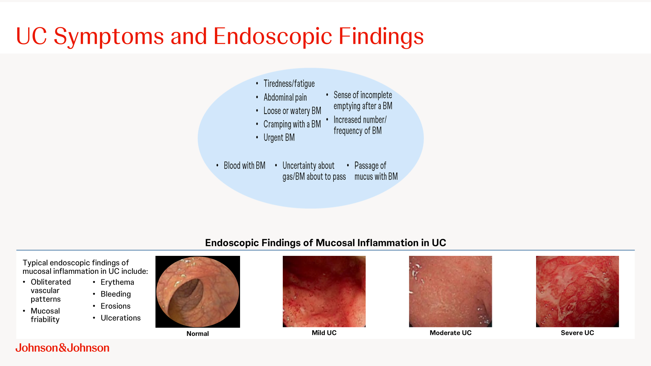

Slide 60
