Slide 1
ICONIC Phase 3 UC H2H
Program Update and Country Outreach
09April2026

Slide 2

Agenda
1
Executive Summary
2
Business Case – Colleen Marano
3
Study Design, Eligibility Criteria, Ideal Site Profile – Yelina Alvarez
4
Feasibility Overview – Liz Monti Sullivan
5
Feasibility Timelines – Liz Monti Sullivan
6
Next Steps – Liz Monti Sullivan

Slide 3
ICONIC Phase 3 UC H2H: Central Team
Colleen Marano, Clinical Program Lead
Yelina Alvarez, SRP
Nicole Houck, SRS
Jeanine Ranaudo, PDL
Li Jen Heng, TDL
Ann Campbell, TDM
Liz Sullivan, Feasibility Lead
Jenifer Eche, Feasibility

Slide 4
Welcome!
Scoped Countries:
Americas | Argentina​
 | Brazil​
 | Canada​
 | Mexico​
 | Peru​
 | United States
APAC | Australia​
 | China​
 | India​
 | Japan​
 | Malaysia​
 | New Zealand​
 | Philippines​
 | Singapore​
 | Taiwan​
 | Thailand​
EMEA | Bulgaria
 | Croatia​
 | Czech​ Republic
 | Estonia​
 | France
 | Germany
 | Hungary​
 | Israel​
 | Latvia​
 | Lithuania​
 | Poland​
 | Romania​
 | Saudi Arabia​
 | Serbia​
 | Slovenia​
 | South Africa​
 | Switzerland​
 | Turkey​

Slide 5
Executive Summary
The ICONIC UC Head‑to‑Head study is a Phase 3b direct comparison trial designed to support access and positioning of icotrokinra in ulcerative colitis, particularly across key EU and RoW markets.
Today we are here to provide key study and enrollment assumptions to support Country Outreach for the ICONIC UC Head‑to‑Head study.
Country Outreach
Apr 2026
Site Outreach
June/July 2026
FSO/FPI
Jan 2027

Slide 6


Business Case: Icotrokinra UC Ph3 program designed for streamlined approval, speed to market & optimal regulatory package
2023 | 2024 | 2025 | 2026 | 2027 | 2028 | 2029 | 2030 | 2031
UC Ph2b (ANTHEM)
UC Ph3 (ICONIC-UC)- RWD; 1 ind., 1 or 2 maint. doses (N~800) + adolescents
LTE
UC Ph3b (ICONIC-UC H2H): Open label
US: Feb’29; EU: May ’29
JP: Jun’29
Phase 3: PbO controlled Registrational Trial
Fastest path to regulatory approval and supports access in major markets including US and Japan
Randomized withdraw design with 1 induction and 1 or 2 maintenance doses (TBD) based on ANTHEM-UC data
  Potential risk of regulators requiring testing two doses in maintenance
  N= 800-900 depending on maintenance design
NO Placebo cross-over in the primary analysis population of the ICO maintenance study
  Induction study ends at Week 12
  Potential to increase 3-4 percentage points in week 52efficacy
LTE duration extended to 4 years
  Supports likely Regulatory PMR for post approval safety monitoring
  Long-term efficacy and safety are critical for positioning
Adolescents (12+yo and >40kg) inclusion
  Unprecedent stand-alone cohort in a registrational trial
  Single arm study matching adult dose, independent of adult timeline indications
  Early pediatric indication ICO positioning
Phase 3b: Direct Comparison Trial (H2H)
Supports Access in key EU/RoW markets
H2H studies are infrequent in UC
  Success case: Vedolizumab demonstrated superiority over adalimumab
  Abbvie has announced H2H vs vedolizumab (REVAMP)
H2H is essential to position ICO as an early therapy in UC
Clinical superiority is a critical driver for medical adoption
Clinical superiority will accelerate access strategy & negotiation with payers
Superior efficacy is critical for clinical guideline recommendations
Recruitment to start when Ph3 fully enrolled
HIGHLY CONFIDENTIAL – Do Not Distribute

Slide 7
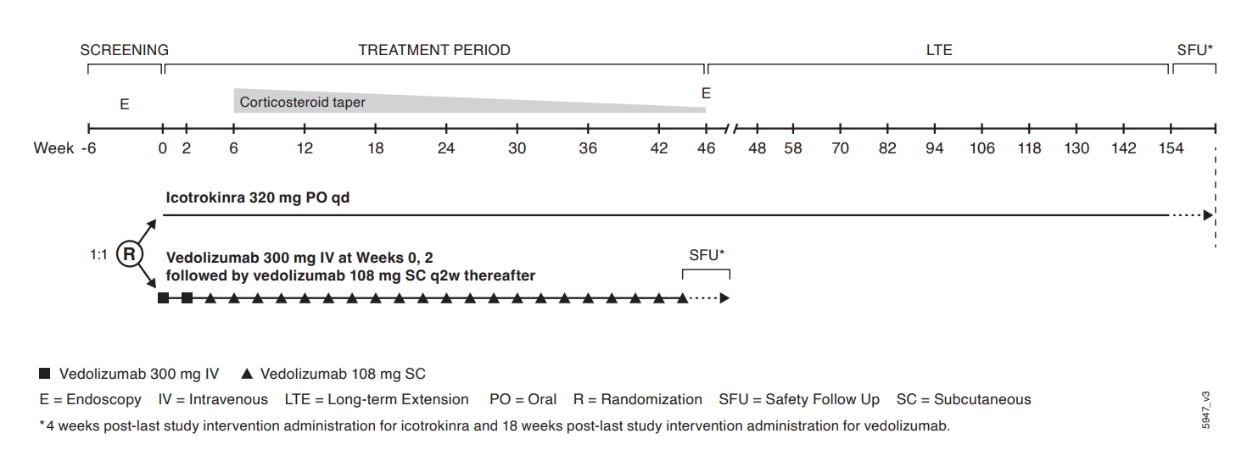
Study Design

Slide 8
Key Inclusion Criteria
≥ 18 years of age
Established UC (at least 12 weeks), modified Mayo 5-9 (central reading of screening video endoscopy), Mayo Endoscopic Subscore (MES) ≥2. Participants with isolated proctitis will be capped at approximately 10% of the total participants enrolled.
ADT-naïve: Demonstrated an inadequate response or failure to tolerate previous conventional therapy ie, 6‑MP, AZA, thioguanine, or corticosteroids (CS)] but are naïve to advanced therapies (approved or investigational therapies) ADT-IR: inadequate response (ie primary or secondary nonresponse) or failure to tolerate advanced therapy defined as biologics and/or advanced oral agents approved for the treatment of UC in the country of use, including: Anti - TNFα antibodies, Anti-interleukin 12/23(p40) antibodies, JAK inhibitors, S1P receptor modulators, or their biosimilars Note: The proportion of participants with inadequate response (ie primary or secondary nonresponse) or intolerance to ≥3 approved advanced therapies (agents, not number of classes) as listed above (in biologic or oral advanced therapies section) will be limited to 15% of the ADT-IR population. Note: The number of participants with inadequate response (ie primary or secondary nonresponse) or intolerance to Anti-interleukin 12/23(p40) (ustekinumab) will be capped at 20% of the ADT-IR population.
Must adhere to protocol requirements for oral 5-ASA, corticosteroids, immunomodulators (stable dosing or discontinuation prior to baseline (Week 0)
Stable dose of GLP-1 agonist for at least 4 weeks prior to baseline (Week 0)

Slide 9
Key Exclusion Criteria
Disease characteristics: Severe UC that might require colonic surgery. Fistulae or strictures. Recent < 24 weeks colonic resection. High- or low-grade colonic mucosal dysplasia.
Infections or Predisposition to Infections: C.diff (must have negative stool testing prior to randomization if treated), active TB or untreated latent TB, HIV+, HBV+, HCV+.
Malignancies: < 5 years (except non-melanoma skin cancer, cervical carcinoma). All lymphoproliferative disorders
Mental Health: Suicidal ideation, suicidal behavior in the last 6 months. Drug (no marijuana) or alcohol abuse in the past year.
Prior/Concomitant Therapy: Any prior exposure to compound targeting IL-23p19, including but not limited to, guselkumab, mirikizumab, or risankizumab, or the IL-23R (including but not limited to icotrokinra). Any prior exposure to compound targeting integrins, including but not limited to vedolizumab. Other compounds such as rectal 5-ASA/corticosteroids, immunosuppressant therapies, JAK inhibitors, S1P receptor modulators and biologic agents (anti- TNFα antibodies, Anti-interleukin 12/23(p40) antibodies) must follow protocol specified washout periods.

Slide 10
Ideal Site Profile
Specialty │ Site Type | PI specialty Gastroenterology, if not, Sub-I specialty must be Gastroenterology University, hospital-based or standalone, community-based practices IBD Clinic, GI Clinic/Digestive Clinic, Research Center
Experience │ Capability | Phase 2 or 3 IBD clinical trial experience With recent J&J IBD experience preferred, prioritizing high enrolling sites Experience performing efficacy procedures/assessments, i.e., Full/Modified/Partial Mayo score Video endoscopy (histology assessments) Inflammatory PD markers (CRP and fecal calprotectin) PRO measures to assess symptom severity, functioning, and HRQoL including: IBDQ, PROMIS 29, and PROMIS Fatigue Short Form 7a
Operational Considerations | Access to large pool of patients with moderately to severely active Ulcerative Colitis who are naïve to advanced therapies (ADT-naïve) and who had an inadequate response or failure to tolerate biologics or oral small molecule therapies (i.e., ADT-IR) Access to patients without prior exposure to anti-IL23p19 antibodies or compounds targeting the IL-23R. Access to patients without prior exposure to vedolizumab. ADT-IR will comprise a minimum of approximately 40% and a maximum of approximately 50% of the population. The proportion of participants with inadequate response (ie primary or secondary nonresponse) or intolerance to ≥3 approved advanced therapies (agents, not number of classes) as listed above (in biologic or oral advanced therapies section) will be limited to 15% of the ADT-IR population. The number of participants with inadequate response (ie primary or secondary nonresponse) or intolerance to ustekinumab will be capped at 20% of the ADT-IR population.

Slide 11
Latest Assumptions on ICONIC UC H2H Trial
The strong momentum from ANTHEM UC and Phase 3 ICONIC UC is expected to continue in the ICO UC H2H study
ICONIC UC H2H study | *Baseline scenario
N | 652
Patient Population | Patients with moderate to severe ulcerative colitis not previously exposed to vedolizumab
Sites | ~300
Countries | TBD
Enrollment period | ~11 Months
Pts/Site/Mo | ~0.16 - 0.18 psm
FSO/FPI | FSO: Mid Jan 2027 FPI: 02 Feb 2027

Slide 12
UC H2H benchmarks: Review
There are limited recently completed H2H trials in moderate to severe UC
Trial Title | Trial Phase | Trial Status | Enrollment Duration | P/S/M | Target N | Sites | P/S | Countries | Pts/Country
A Phase 3b, Randomized, Double-Blind, Parallel-Arm, Placebo- and Active- Controlled Treat-Through Study of Mirikizumab and Vedolizumab in Participants With Moderately to Severely Active Ulcerative Colitis, Eli Lilly | III | Terminated | 31.8 | 0.15 | 1100 | 236 | 4.7 | 34 | 32
A Randomized, Double-blind, Multicenter Phase 3 Study in Patients With Moderately to Severely Active Ulcerative Colitis (UC) to Compare the Efficacy, Safety and Immunogenicity of PB016 and Entyvio® for the Induction and Maintenance of Clinical Response and Remission, Polpharma | III | Open | 23.8 | 0.16 – TBD | 750 | 200 | 3.8 | 17 | 44
Parallel-Group Treatment, Double-Blind, 2-Arm to Investigate Comparative Efficacy Safety Immunogenicity Between Intravenous AVT16 and Entyvio® in Male and Female Subjects 18 to 80 Years Inclusive, Moderate to Severe Ulcerative Colitis, Alvotech | III | Open | 16.7 | TBD | 748 | 100 | 7.5 | 17 | 8
Phase 3b, Multicenter, Randomized, Open-Label Study of Risankizumab Compared to Vedolizumab for the Treatment of Adult Subjects With Moderate to Severe Ulcerative Colitis Who Are Naïve to Targeted Therapies, AbbVie | III | Open | 27.9 | 0.07 – TBD; 0.09 as of Jan26 | 530 | 285 | 1.9 | 29 | 18
Comparison of Medical RESCUE Strategies for Patients With Steroid-refractory Acute Severe Ulcerative Colitis: an Open-label Randomized Controlled Trial (RESCUE-UC).AbbVie | III | Planned | 20.0 | TBD | TBD | TBD | TBD | TBD | TBD
Trial | Countries in most recent or ongoing UC H2Hs
Eli Lily | Argentina; Australia; Austria; Belgium; Brazil; Canada; Croatia; Czech Republic; Denmark; France; Germany; Hungary; India; Italy; Japan; Latvia; Lithuania; Malaysia; Mexico; Netherlands; Poland; Portugal; Romania; Russia; Serbia; Slovakia; South Africa; South Korea; Spain; Switzerland; Turkey; Ukraine; United Kingdom; United States
Polpharma | Albania; Australia; Bosnia and Herzegovina; Brazil; Bulgaria; Czech Republic; Georgia; Hungary; India; Israel; Latvia; Moldova Republic; Poland; Romania; Slovakia; South Africa; Turkey
Alvotech | Argentina; Bosnia and Herzegovina; Bulgaria; Colombia; Croatia; Georgia; India; Italy; Latvia; Mexico; Peru; Poland; Romania; Serbia; Slovakia; Sri Lanka; Ukraine
AbbVie | Austria, Brazil, Bulgaria, Canada, China, Croatia, Estonia, Finland, Germany, Hungary, Ireland, Israel, Italy, Latvia, Lithuania, Mexico, Netherlands, Poland, Puerto Rico, Saudi Arabia, Slovenia, South Korea, Spain, Sweden, Switzerland, Taiwan, United Arab Emirates, United Kingdom, United States
AbbVie | Not yet available
In green, countries overlap with current country list for country outreach

Slide 13
Summary of expectations
Based on ANTHEM UC and ongoing Phase 3 ICONIC UC experience, the ICO UC H2H study is expected to achieve accelerated enrollment, with recruitment rates of approximately 0.15–0.18 patients/site/month.
The active‑comparator design (icotrokinra vs vedolizumab), absence of placebo, and strong value proposition are expected to drive high site and patient engagement, supporting enrollment performance comparable to or slightly faster than ANTHEM UC and the Phase 3 ICONIC UC trial.
Exclusion of participants with prior exposure to compounds targeting IL‑23 p19 (guselkumab, mirikizumab, risankizumab) or IL-23R (icotrokinra), and/or integrins (vedolizumab) narrows the eligible population (bio‑naïve, TNFα antibodies, ustekinumab, JAK inhibitors, SIP receptor modulators and their biosimilars), potentially limiting country footprint and slowing recruitment.
Majority of countries will overlap with ICONIC IBD footprint; therefore, we may want to identify/select countries that do not have vedo approved in country.
Biggest risk remains: no prior performance data in this precise patient population with exclusion of those exposed to vedolizumab. To mitigate for this risk, the global footprint includes countries without approval or launch of vedo.

Slide 14
Country Selection Criteria
A balance of countries with rich JNJ IBD experience and those without vedolizumab approval.
The list of 34 countries in the following slide includes a mix of markets where biologics are/aren’t approved (suggesting ADTs and potential high unmet need); where nearly half do not have vedo approved, half have recent JNJ experience and many very rich experience, some where we conduct IBD trials often where they have less ADTs available (where this could be attractive to pts).
It’s expected that a country footprint representing a balance of the following will be most successful in supporting the H2H:
Vedo not approved
Bio-IR pt pop high, suggesting high unmet need for sicker pts
Bio-IR pt pop high, ADTs limited
JNJ experience in ~50%
Bio-naïve pt population suggesting lower vedo exposure
DUET ENCORE’s treatment pathway survey results:
UC - vedo was cited as the 2nd commonly prescribed 1st line predominantly used in moderate patient ranges (31–45%)

Slide 15
Country Outreach list
Sweet spots:
1) countries where vedo is not approved
2) countries where bio-IR recruitment is higher suggesting sicker populations/higher unmet need
3) countries where bio-IR recruitment is higher AND therapeutic options may be limited for mod-severe pts (ex: no vedo approval or adoption low)
Country | Number of biologics launched for UC | Vedo launched | ICONIC IBD | Non-Core | Recent JNJ experience | Comments
USA | 40 | x | x |  | x | 61% bio-IR recruiting population suggesting an unmet need in sicker pts
Croatia | 24 |  |  | x | x | vedo not approved bt higher # of ADTs approved suggesting unmet need in sicker pts
Czech | 29 | x | x |  | x | recruits bio-naïve suggesting lower vedo exposure; exceeded their target in anthem uc
Estonia | 23 |  |  | x | x | vedo not approved
Hungary | 27 |  | x |  | x | Vedo not approved
Latvia | 23 |  |  | x |  | vedo not approved
Lithuania | 23 |  |  | x |  | Vedo not approved
Poland | 29 | x | x |  | x | nearly all bio-naïve recruitment which suggests higher pt availability of those not exposed to vedo
Romania | 23 | x | x |  | x | high bio-naïve recruitment suggesting lower vedo exposure
Slovenia | 23 |  |  | x | x | vedo not approved
France | 28 | x | x |  | x | Top contributor in ICONIC UC
Bulgaria | 24 | x |  |  | x | Recommended based on infrastructure and limited access to vedo
Germany | 30 | x | x |  | x | Top contributor in JNJ IBD trials, larger population
Australia | 19 | x | x |  | x | slightly higher bio-IR recruitment population; less options available; exceeded their anthem uc target
Canada | 23 | x | x |  | x | slightly higher bio-IR recruitment population; less options available
China | 22 | x | x |  | x | Exceeded anthem uc target; higher bio-IR pop and less therapy options
Japan | 17 | x | x |  | x | less biologics approved, large population, top UC contributor
India | 14 | x | x |  | x | less biologics approved; exceeded anthem uc target by 325%
New Zealand | 7 |  |  | x* | x | vedo not approved; less biologics approved
Switzerland | 9 |  | x |  | x | vedo not approved; less biologics approved
Taiwan | 10 |  | x |  | x | recruits 67% bio-IR suggesting sicker pts, less options available
Brazil | 8 | x | x |  | x | high bio-IR recruitment may mean sicker pts with less options; achieved 200% of their anthem uc plan
Israel | 7 | x | x |  | x | 91% bio-IR recruiting population suggesting unmet need; less options available
Malaysia | 8 | x | x |  | x | less biologics approved; recruits higher bio-naïve; achieved 325% of their anthem uc plan
Peru | 2 |  |  | x |  | Vedo not approved; less biologics approved
Saudi Arabia | 4 |  |  | x | x | vedo not approved; less biologics approved
Singapore | 8 |  |  | x |  | vedo not approved; less biologics approved
Mexico | 7 |  |  |  | x | vedo not approved; less biologics approved
Philippines | 3 | x |  | x |  | less biologics approved
Serbia | 4 |  |  | x |  | vedo not approved; less biologics approved
South Africa | 4 |  |  |  | x | vedo not approved; less biologics approved
Thailand | 4 |  |  |  |  | vedo not approved; less biologics approved
Turkey | 6 |  | x |  | x | recruits 71% bio-IR suggesting sicker pts, less options ; exceeded their target in anthem uc
Argentina | 6 |  | x |  | x | vedo not approved; less biologics approved; achieved 216% of their anthem uc plan
x* cross-border NCC

Slide 16
Country Considerations requiring GCO Feedback
Vedolizumab considerations
Determine the level of reimbursement/insurance coverage for vedolizumab (Fully / Partially / Not covered). - need to understand if pts have access to vedo and if it’s reimbursed. If vedo is launched in country but not well adopted due to coverage barriers, there may be better opportunity.
Confirm whether IV dosing followed by SC self‑administration is approved in the country
Central sourcing
For where vedo is approved and adopted, what percentage of the population may be eligible?
If vedolizumab is not approved, could this provide a recruitment advantage?
REVAMP (competitor study) is ongoing and has recruited ahead of schedule. Local teams to consider competitive sites and whether there may be benefit in partnering with them.
Post Trial Access (PTA) requirement
Will this be an issue for countries that don’t have vedo approved? (JNJ can’t provide post trial access for vedo)
Interest & Engagement
Overall interest in study participation
Principal Investigator (PI) interest level: high / moderate / low
Patient interest level: high / moderate / low (particularly considering access to the comparator drug)
Additional considerations:
Concerns with country and site overlap across multiple JNJ IBD trials
Country start up timelines
Regulatory experience/operational conduct in countries with less JNJ experience
PED will not be available to support Country Outreach activities. Please use the information within this presentation

Slide 17
Next Steps
Please refer to this link to respond to questions and update and/or validate your country’s specific performance ranges. This information should help guide final commitments once site outreach has been completed and final country selections are made
Please complete this validation by 05May2025
Baseline Lock December 2026
Site Outreach to launch in June and to conclude end of July 2026
Protocol Training and Site Feasibility Kick off Meeting week of 18May2026

Slide 18
Questions?

Slide 19
Back up

Slide 20
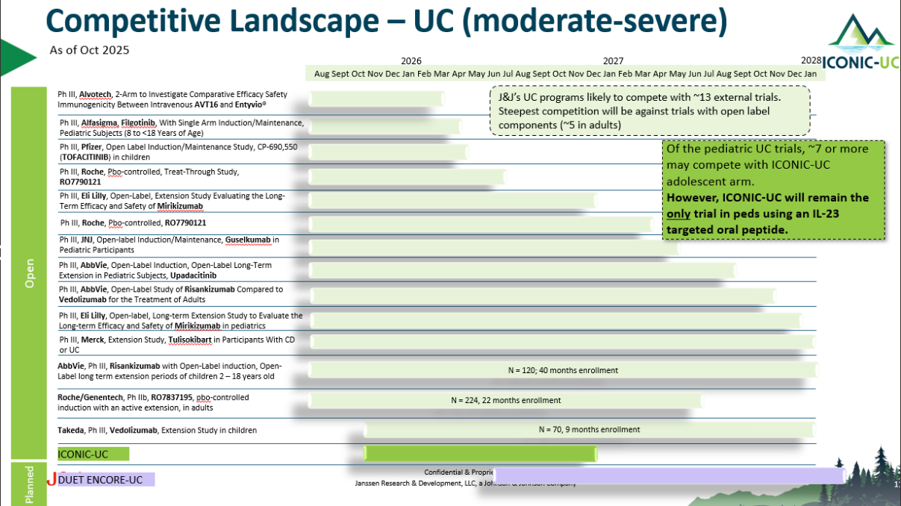

Slide 21
Benchmark insights:
Phase 2/3 and 3 UC Industry Sponsored Trials, last 5 years, N=16
Patient availability informs country and site needs
Percentiles | Sites | Countries | Pts/Site Capacity | Pts/Site/Month | Enrollment Duration
P10 | 167.50 | 24.0 | 0.81 | 0.04 | 14.42m
P25 | 199.25 | 26.8 | 0.86 | 0.05 | 21.15m
P50 | 424.50 | 36.5 | 1.21 | 0.07 | 24.47m
P75 | 486.50 | 40.0 | 1.78 | 0.09 | 31.30m
P90 | 544.50 | 46.0 | 2.74 | 0.11 | 43.84m
Average | 370 | 35 | 1.5 | 0.07 | 27m
Internal Trial | Sites | Countries | Pts/Site Capacity | Pts/Site/Month | Enrollment Duration
Anthem UC (N=240) | 200 | 22 | 1.2 | 0.15 | 8m
ASTRO (N=418) | 310 | 29 | 1.5 | 0.11 | 18.3m
DUET UC (N=550) | 491 | 49 | 1.1 | 0.07 | 20m
QUASAR (N=1000) | 524 | 36 | 2.0 | 0.08 | 35m

Slide 22








IBD External Competitive Landscape
Ulcerative Colitis snapshot
JNJ’s Competitive Edge is Steadfast
No other program includes an IL-23 target oral peptide, making JNJ4804 and JNJ2113 programs uniquely and well positioned.
Of phase 2/3 and 3 UC trials: need to update
27 open and/or planned global trials
  20 open; 7 planned
  ~15 trials expected to be active at JNJ2113 FSO
Key competitors | Drug/s | Target
Eli Lilly | Mirikizumab | IL-23 antagonist
Pfizer | ritlecitinib | JAK inhibitor
BMS | Ozanimond | Sphingosine 1-phosphate 1 receptor agonist; Sphingosine 1-phosphate 5 receptor agonist
Abivax | Obefazimod | HIV rev inhibitor; MicroRNA stimulant
AbbVie | Upadacitinib | JAK inhibitor
Roche | PF-06480605 | TNF superfamily member 15
Merck | Tulisokibart | Tumour necrosis factor ligand 1A antagonist; Immune checkpoint stimulant
Takeda | vedolizumab | Immunosuppressant; Alpha4beta7 integrin antagonist

Slide 23
UC Competitive Launch Timeline
Marketed
2025
2026
2027
2028
2029
2030
2031
2032+
JAK
Xeljanz, Rinvoq, Jyseleca (EU-only)
Ritlecitinib
Pfizer: P2 (Q4’28)
S1P
Zeposia, Velsipty
VTX-002
Ventyx: P2 (1H’29)
Orals
TAK-279
Takeda: P2 (Q4’31)
TYK2
IL23
Icotrokinra (Q1’29)
Other
Obefazimod
Abivax: P3 (Q3’27)
MORF057 a4B7
Lilly: P2 (Q1’30)
2 RIPK1’s
Abbvie: Q3’31
Sanofi: Q1’31
Marketed
2025
2026
2027
2028
2029
2030
2031
2032+
aTNF
REMICADE, Humira, SIMPONI, IFX & ADA Biosimilars
IL12/23
STELARA
Ustekinumab Biosimilar Q1’25 US
SQ/IV
a4b7
Entyvio IV & SC
IL23
Omvoh, Skyrizi, TREMFYA
Skyrizi SC Induction:
TBD
TL1A
MK7240
Merck: P2 (Q2’28)
RG6631
Roche: P2 (Q4’28)
TEV48574
Teva: P2 Q4’29)
Combos
JNJ-4804 (Q2’29)
As of January 2025
Notes:
Ventyx discontinued in PsO and PsA d/t efficacy results from P2 study in PsO (11/6/23)

